Slide 1

PROJECT REPORT
RIZAL ELEMENTARY SCHOOL

Slide 2

On behalf of the entire community of Rizal Elementary School and the Handmaids of the Sacred Heart of Jesus, we would like to extend our heartfelt thanksgiving for your generous donation towards the construction of much-needed classroom for Grade 5 and 6 students.

Slide 3
Your selfless support has created a lasting impact on the lives of students who now have access to a more conducive and dignified learning environment.

Slide 4
Your gift is more than just bricks and mortar – it is a symbol of hope, opportunity, and compassion. For the many young minds from poor and underprivileged backgrounds who walk-through the doors of these classrooms, your kindness has opened the path toward a better future.

Slide 5


DELIVERY
OF
MATERIALS

Slide 6
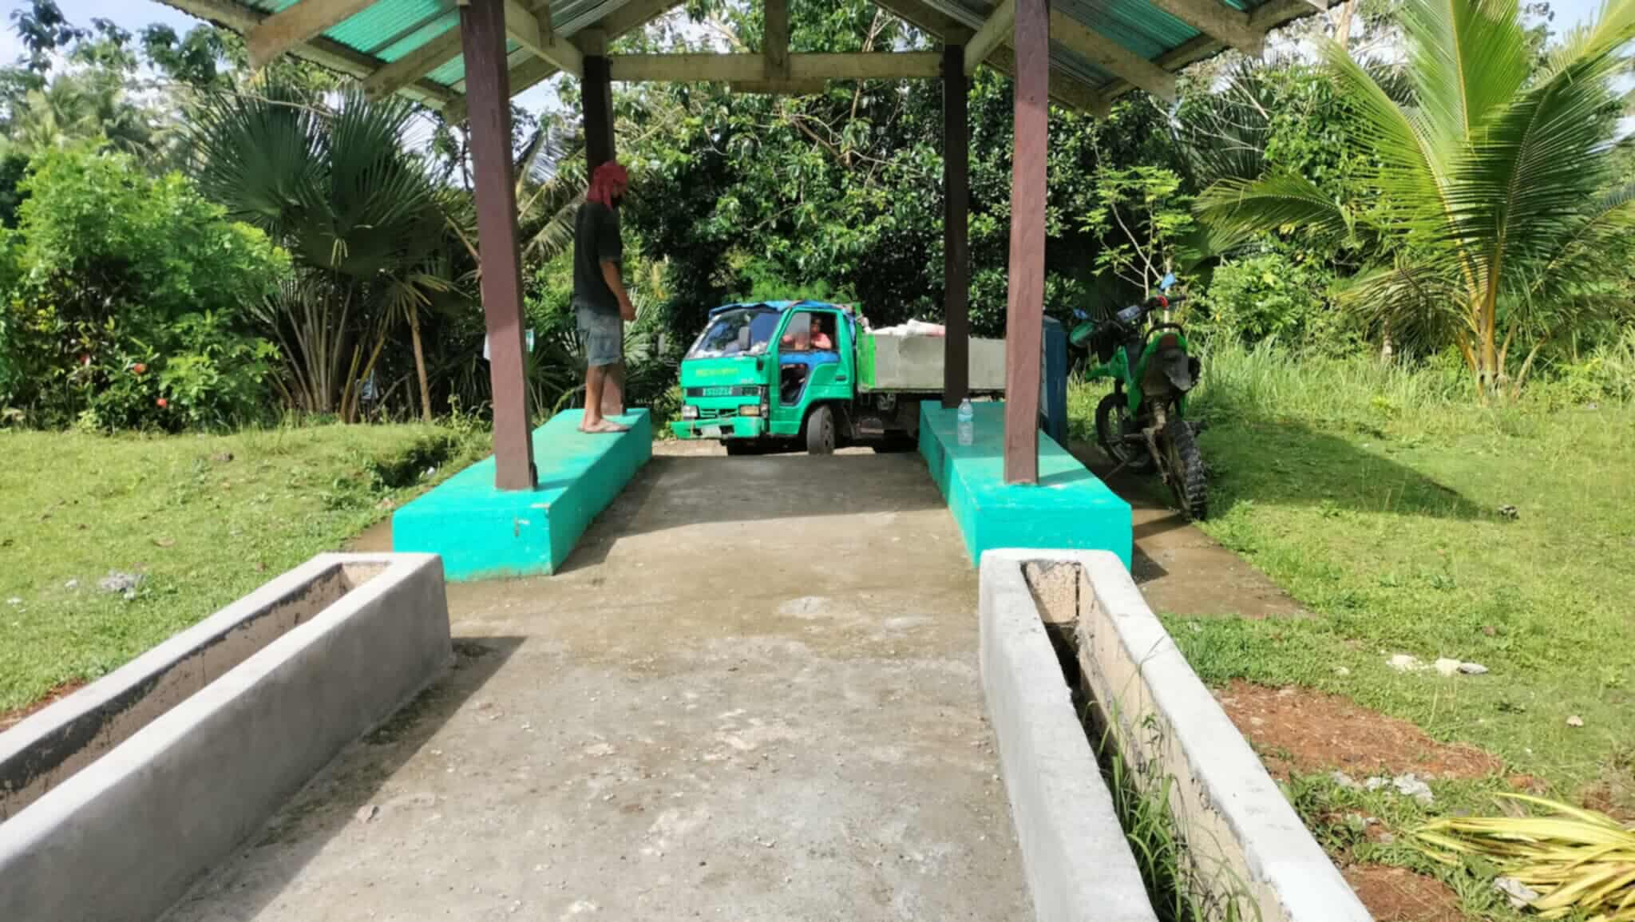

Slide 7
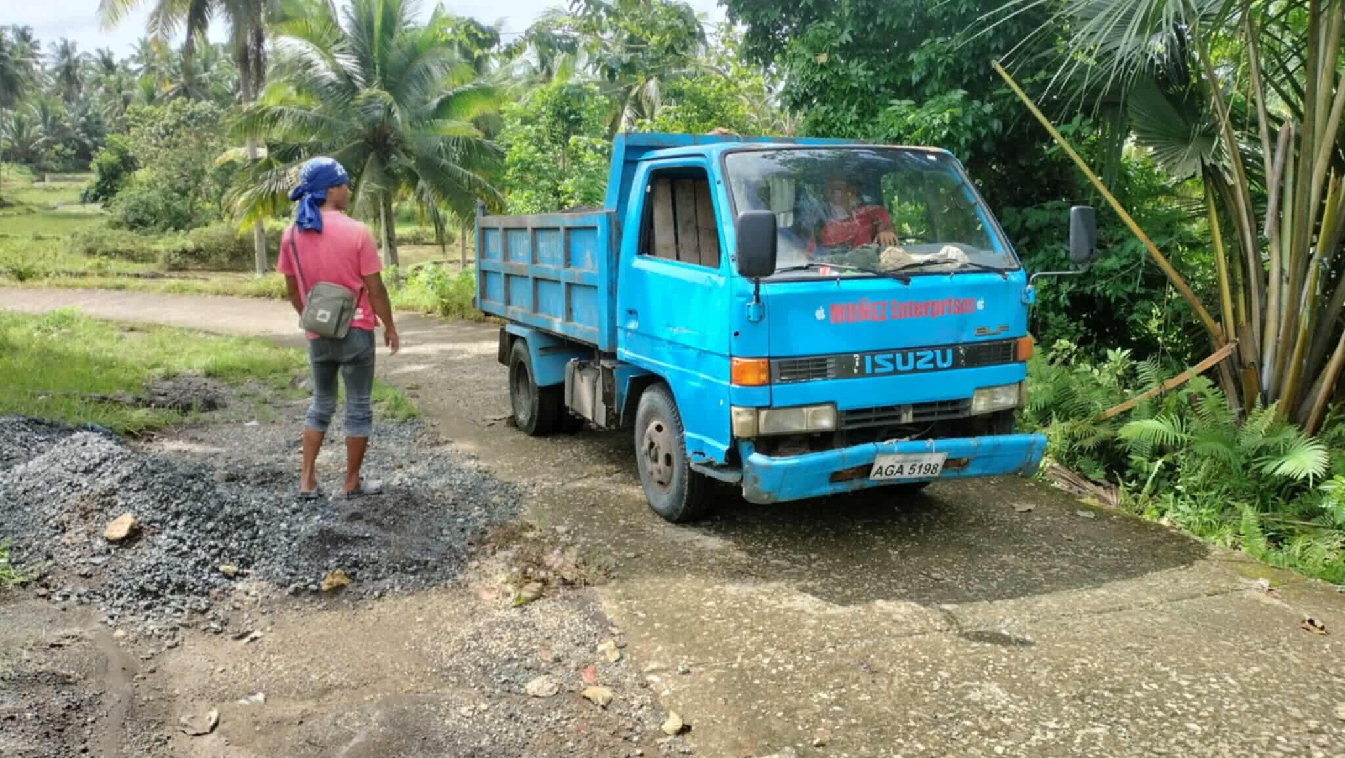

Slide 8
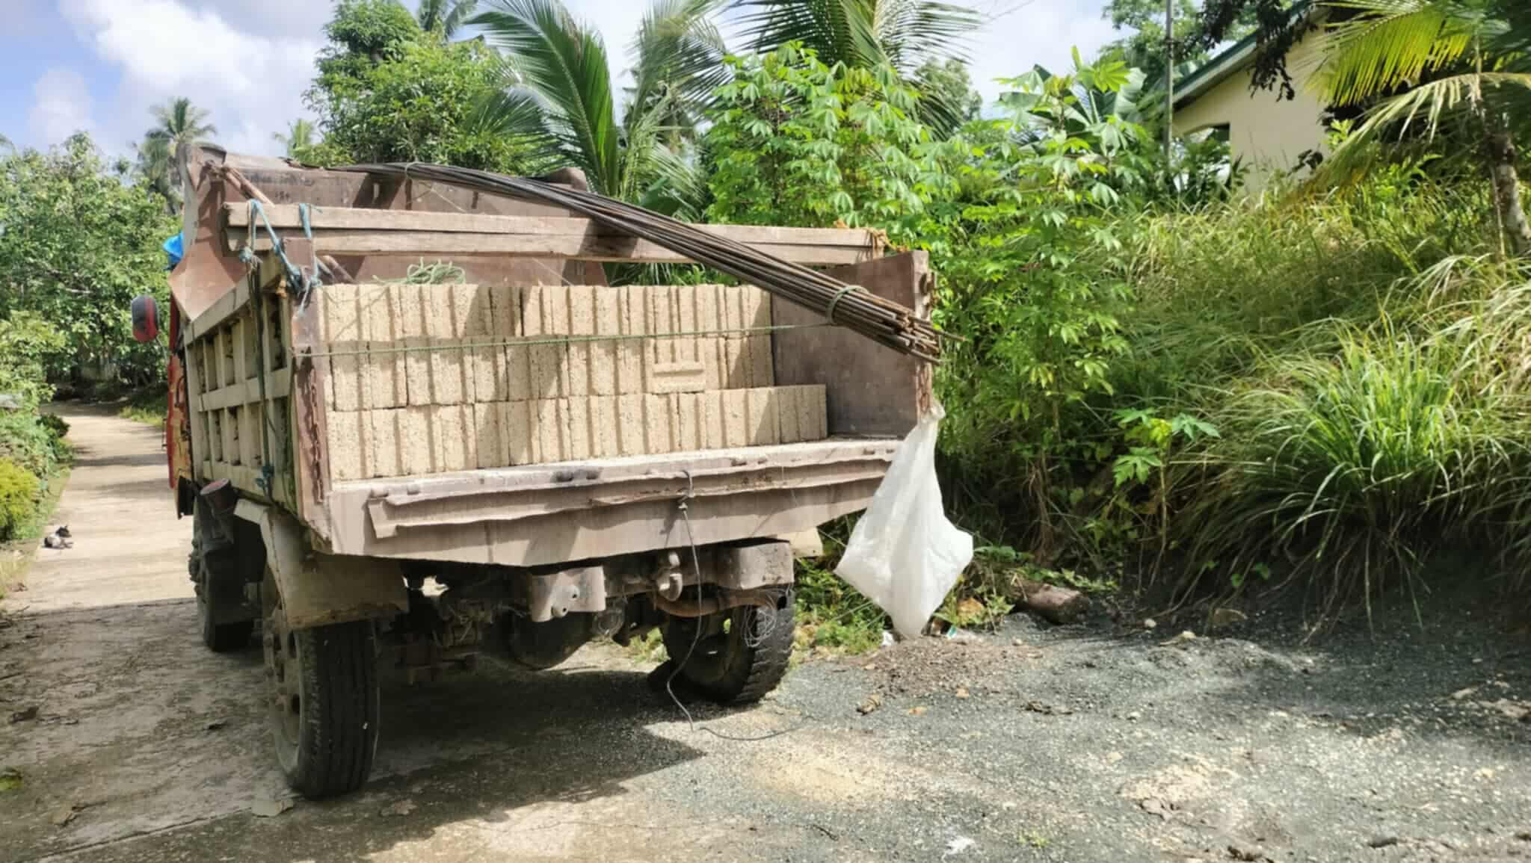

Slide 9
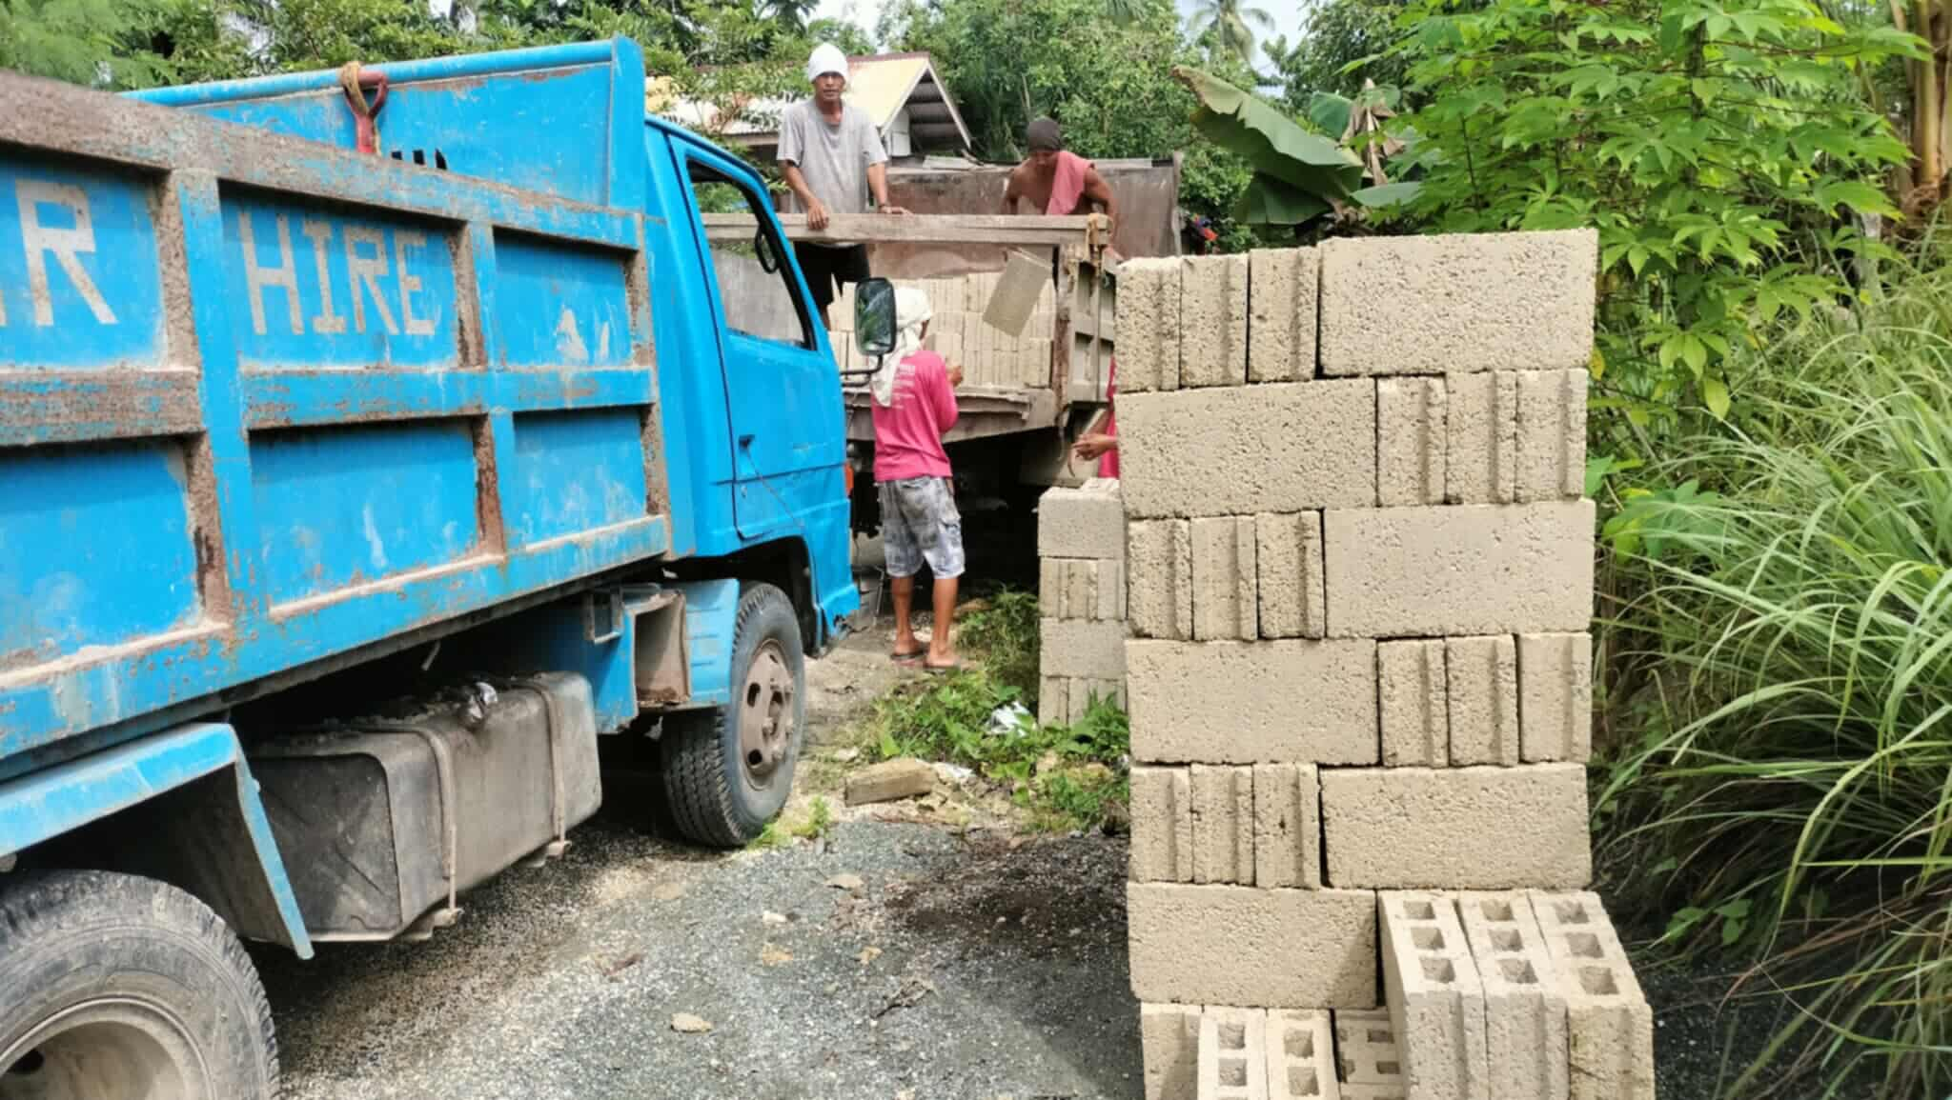

Slide 10
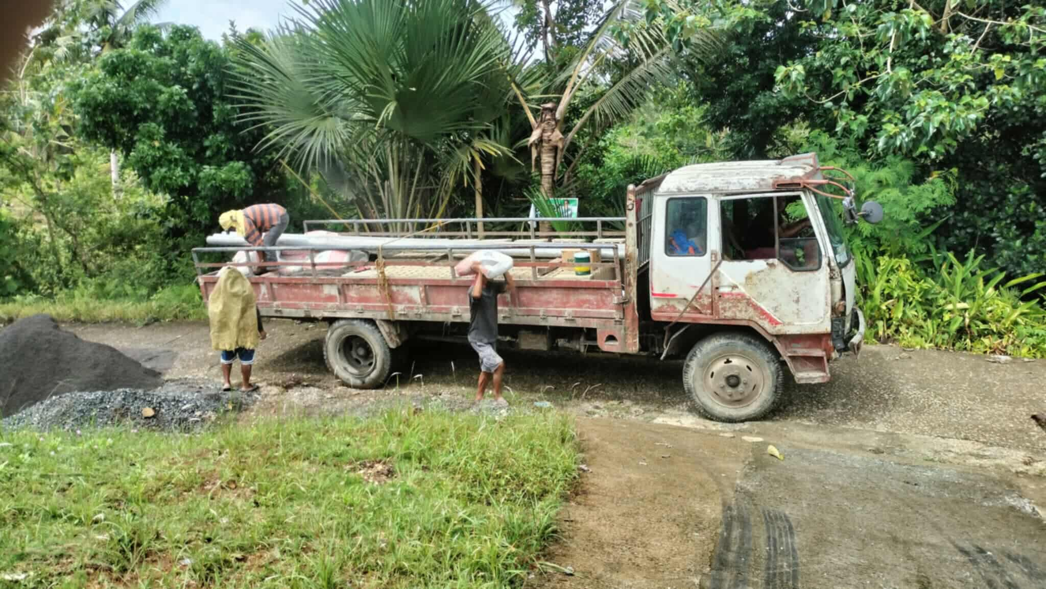

Slide 11
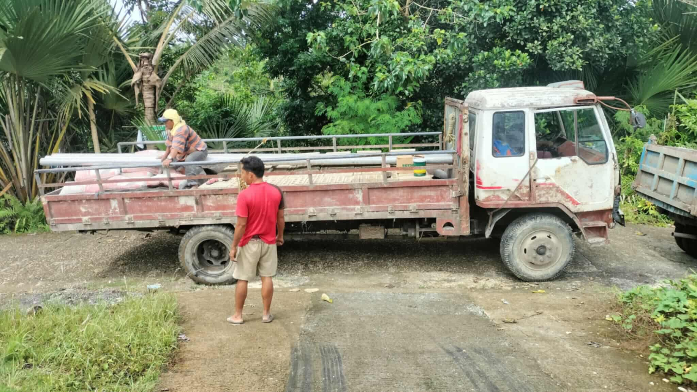

Slide 12
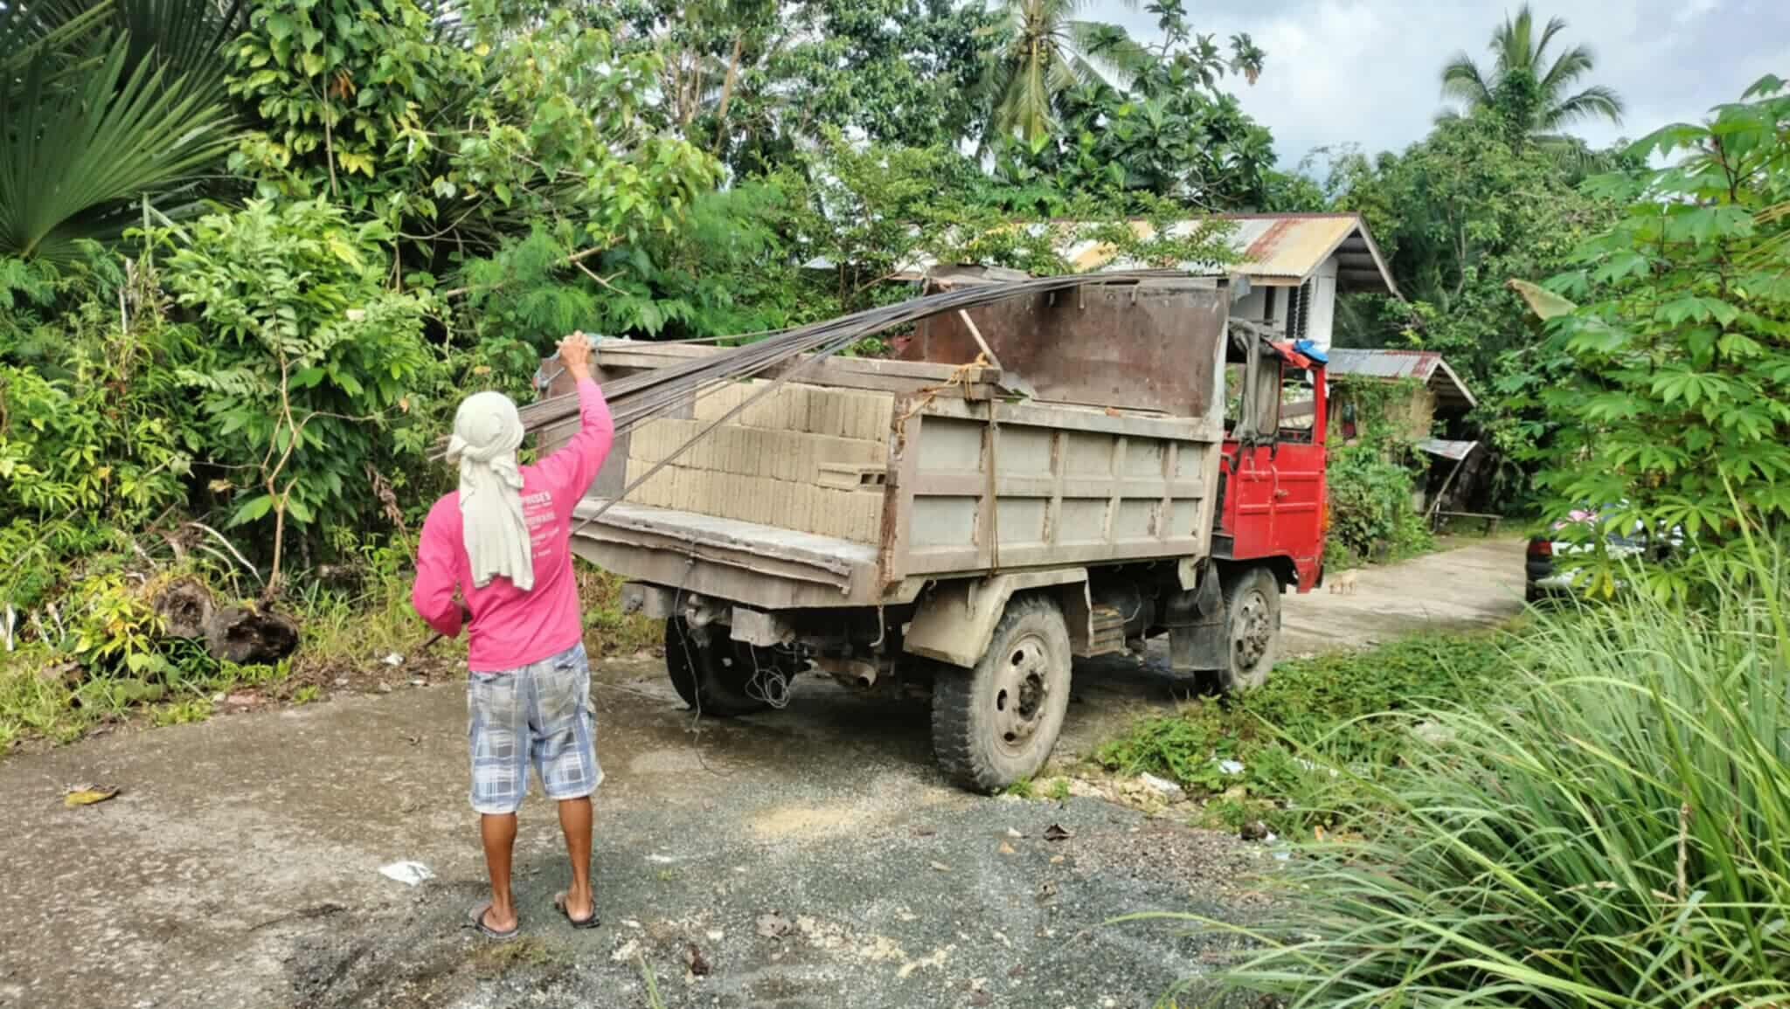

Slide 13
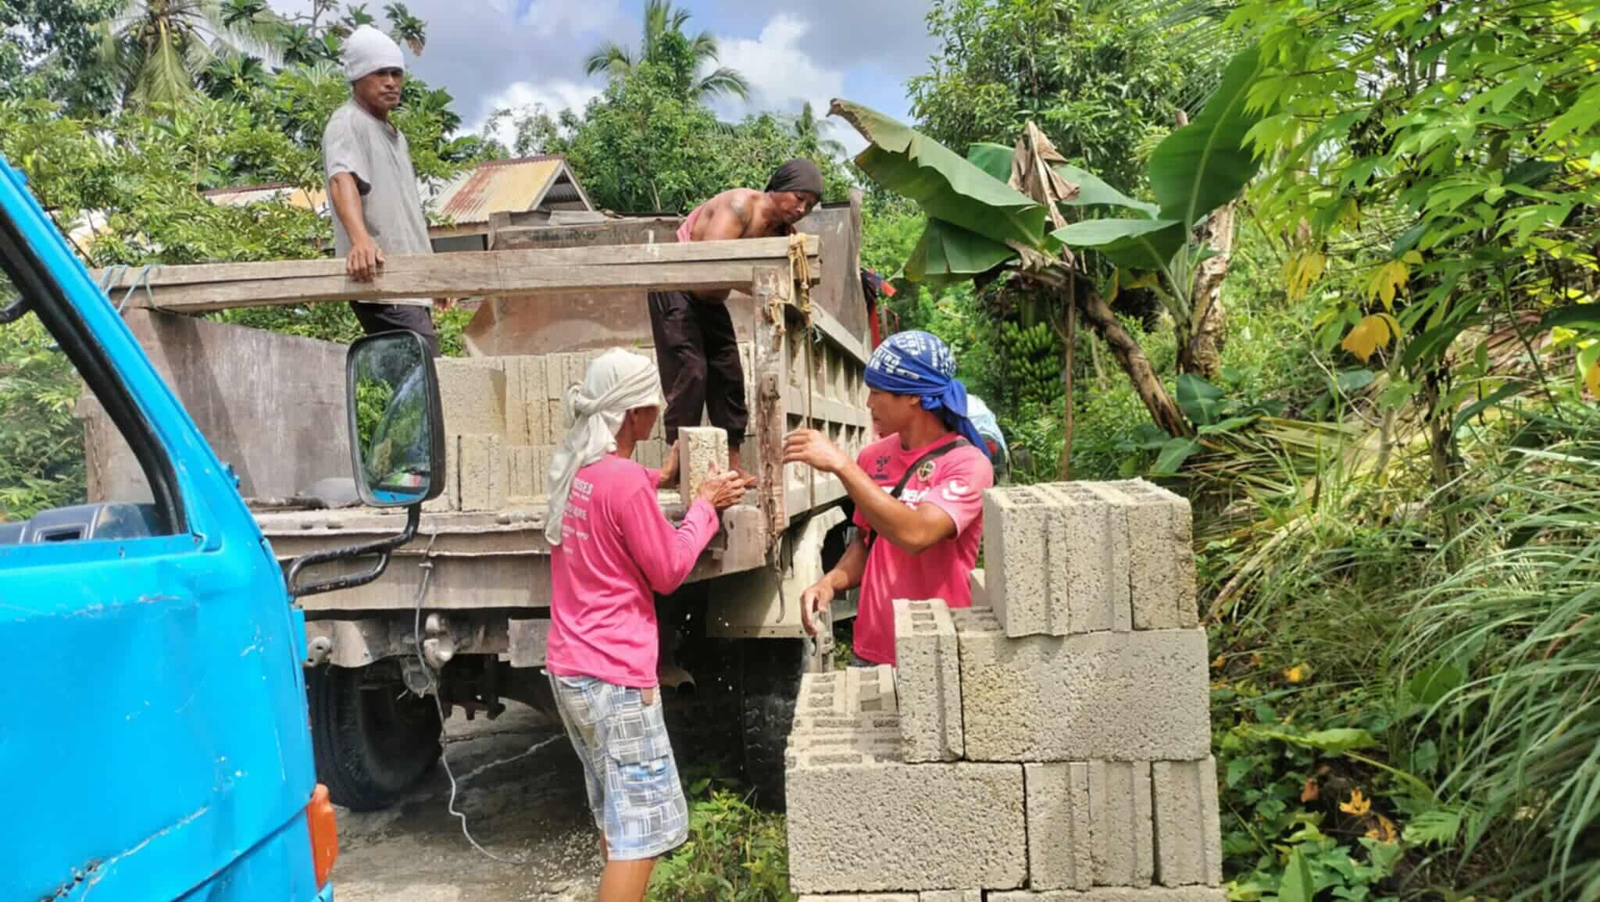

Slide 14
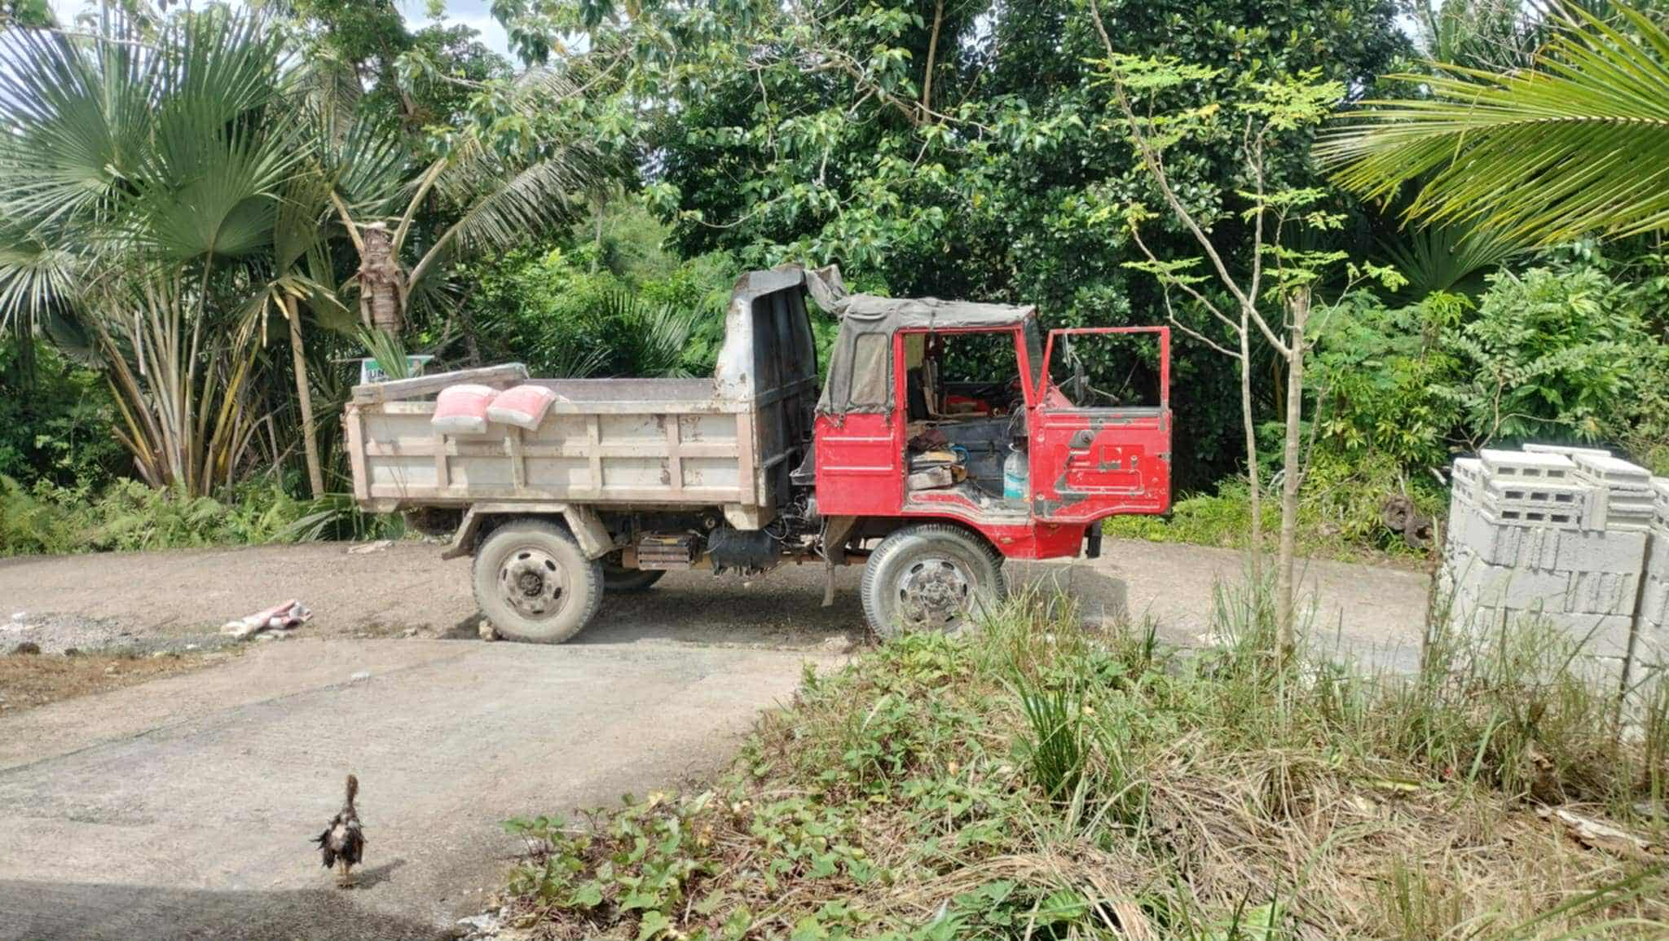

Slide 15

CONSTRUCTION

Slide 16
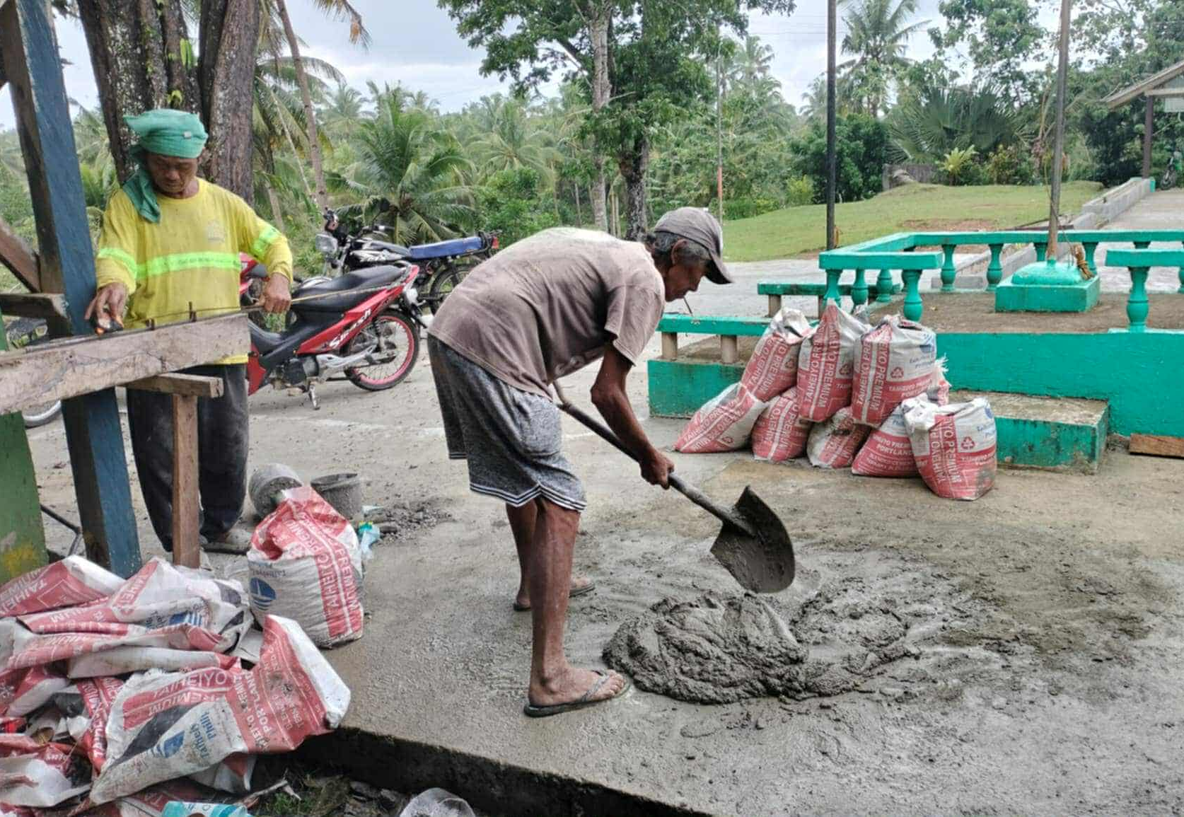

Slide 17
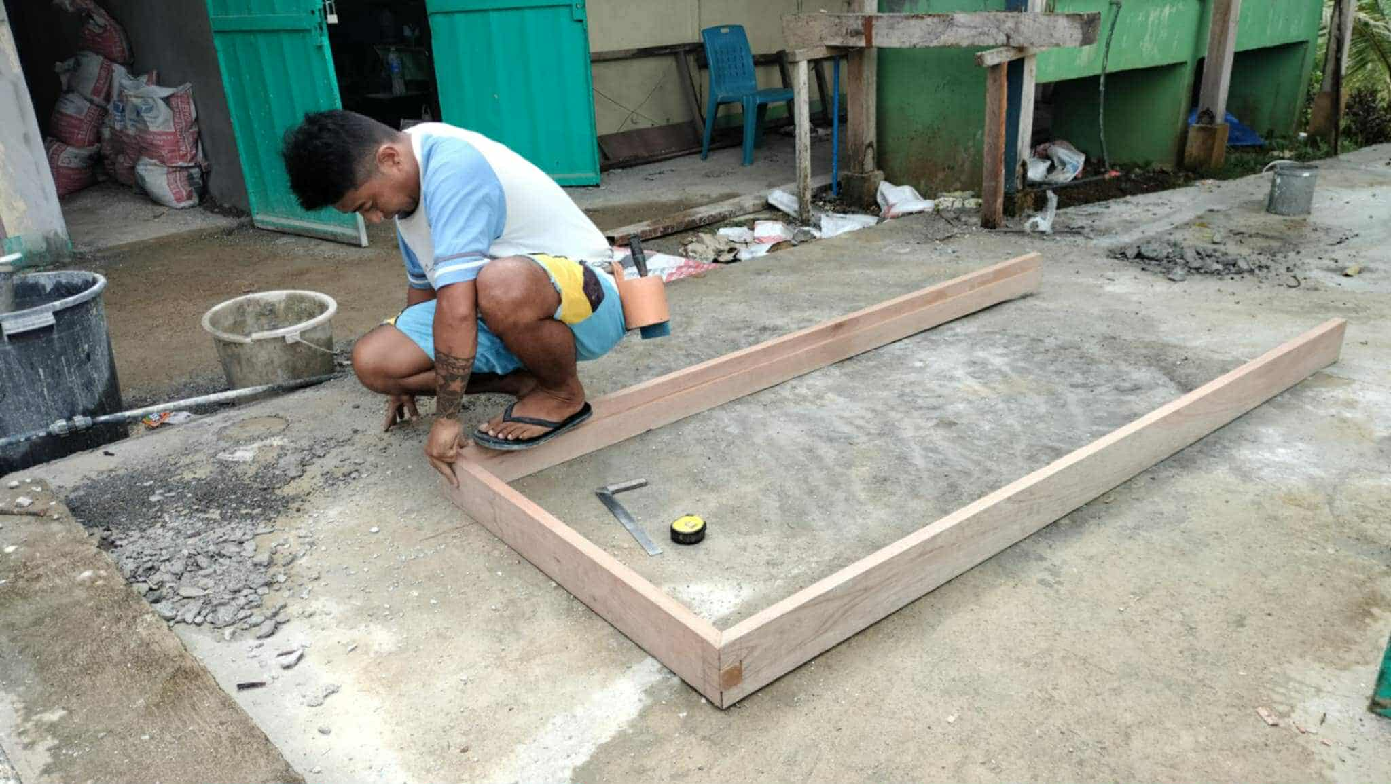

Slide 18
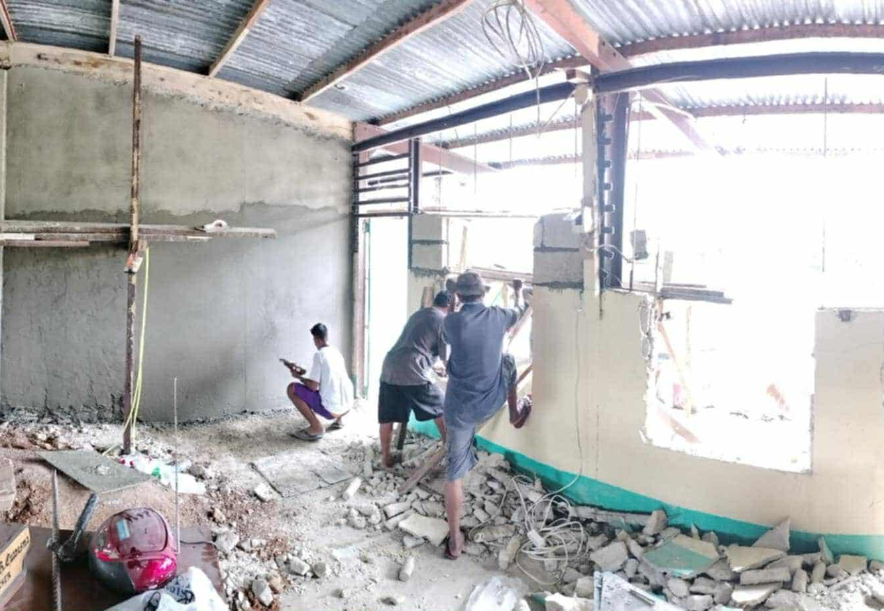

Slide 19
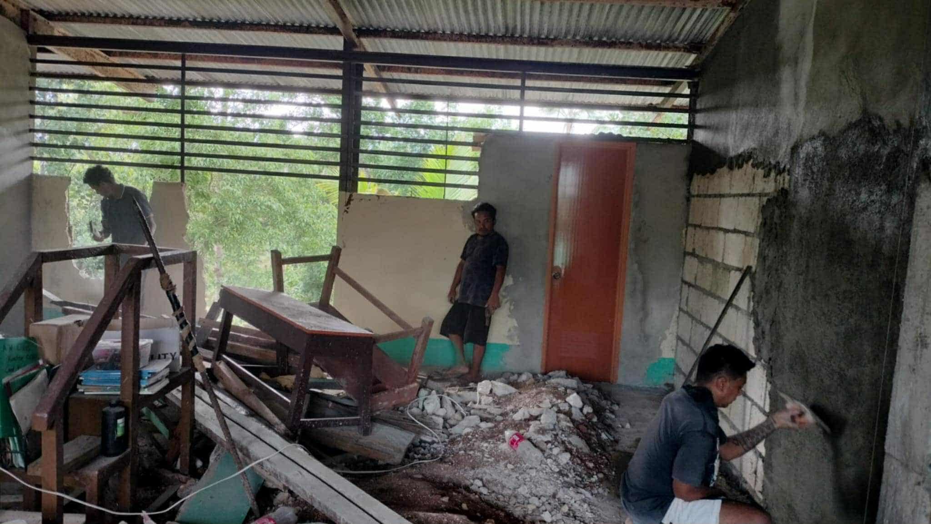

Slide 20
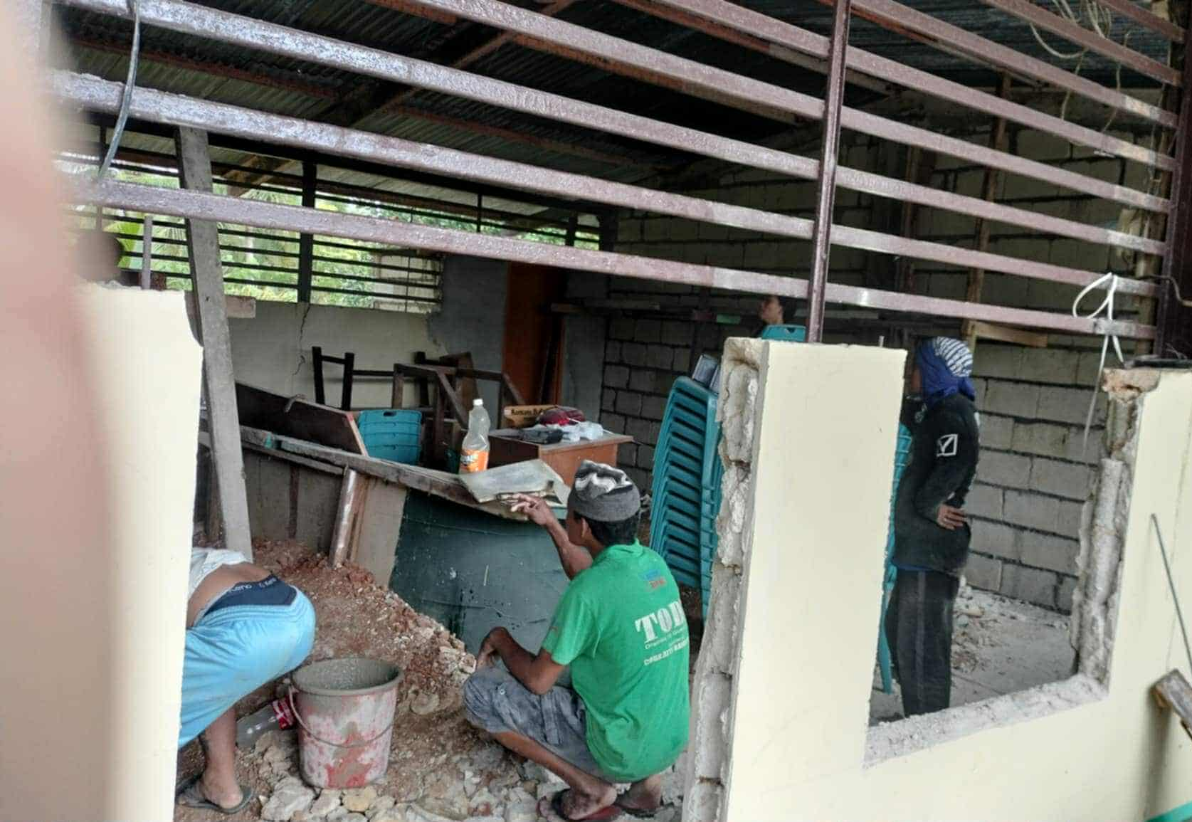

Slide 21
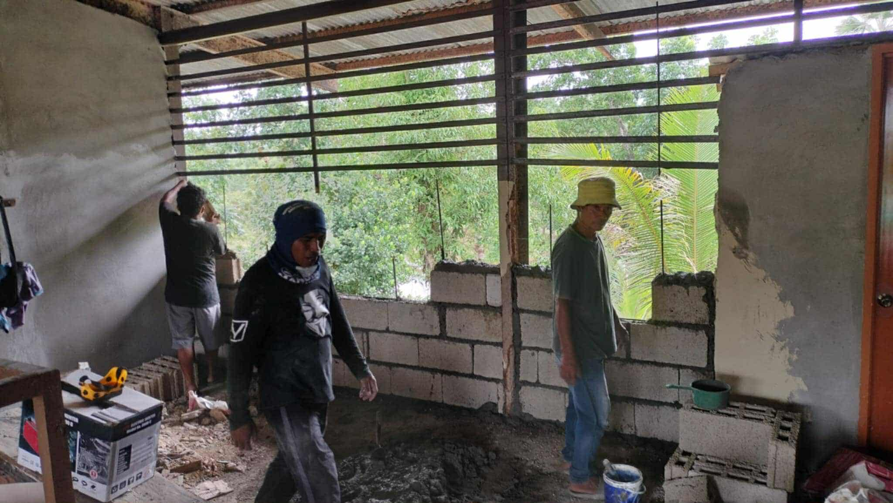

Slide 22
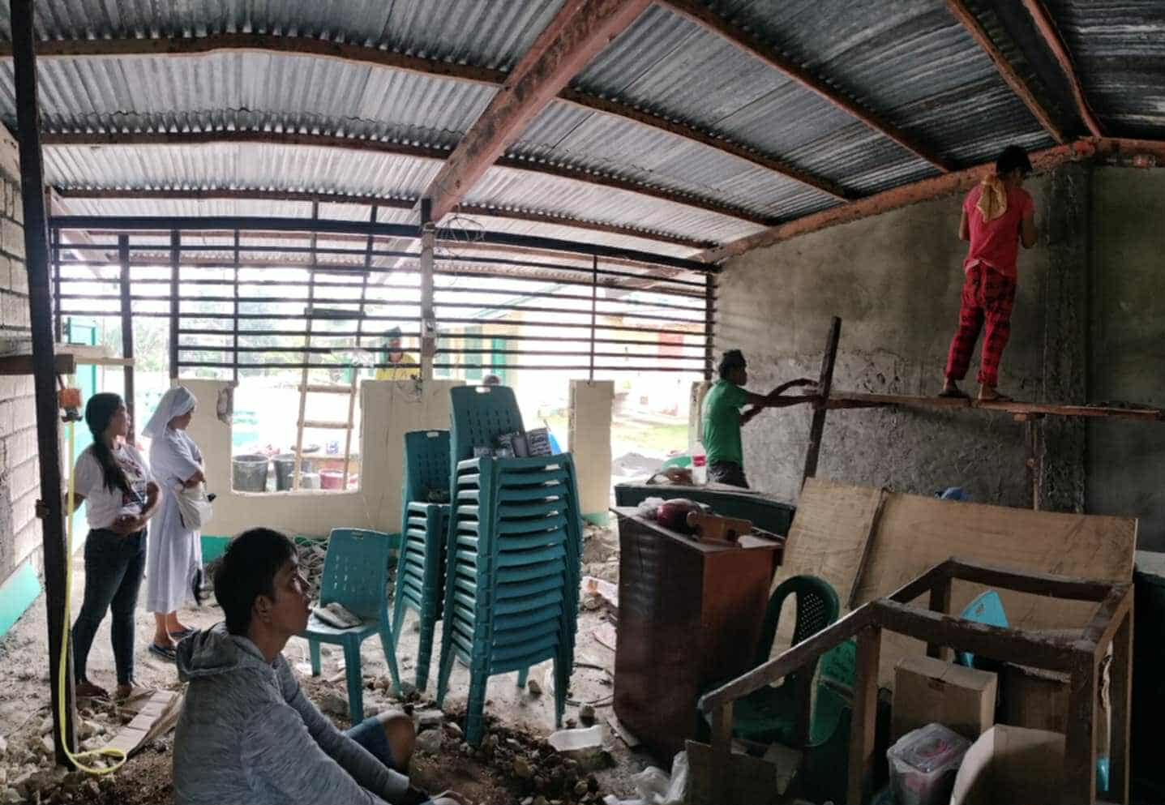

Slide 23
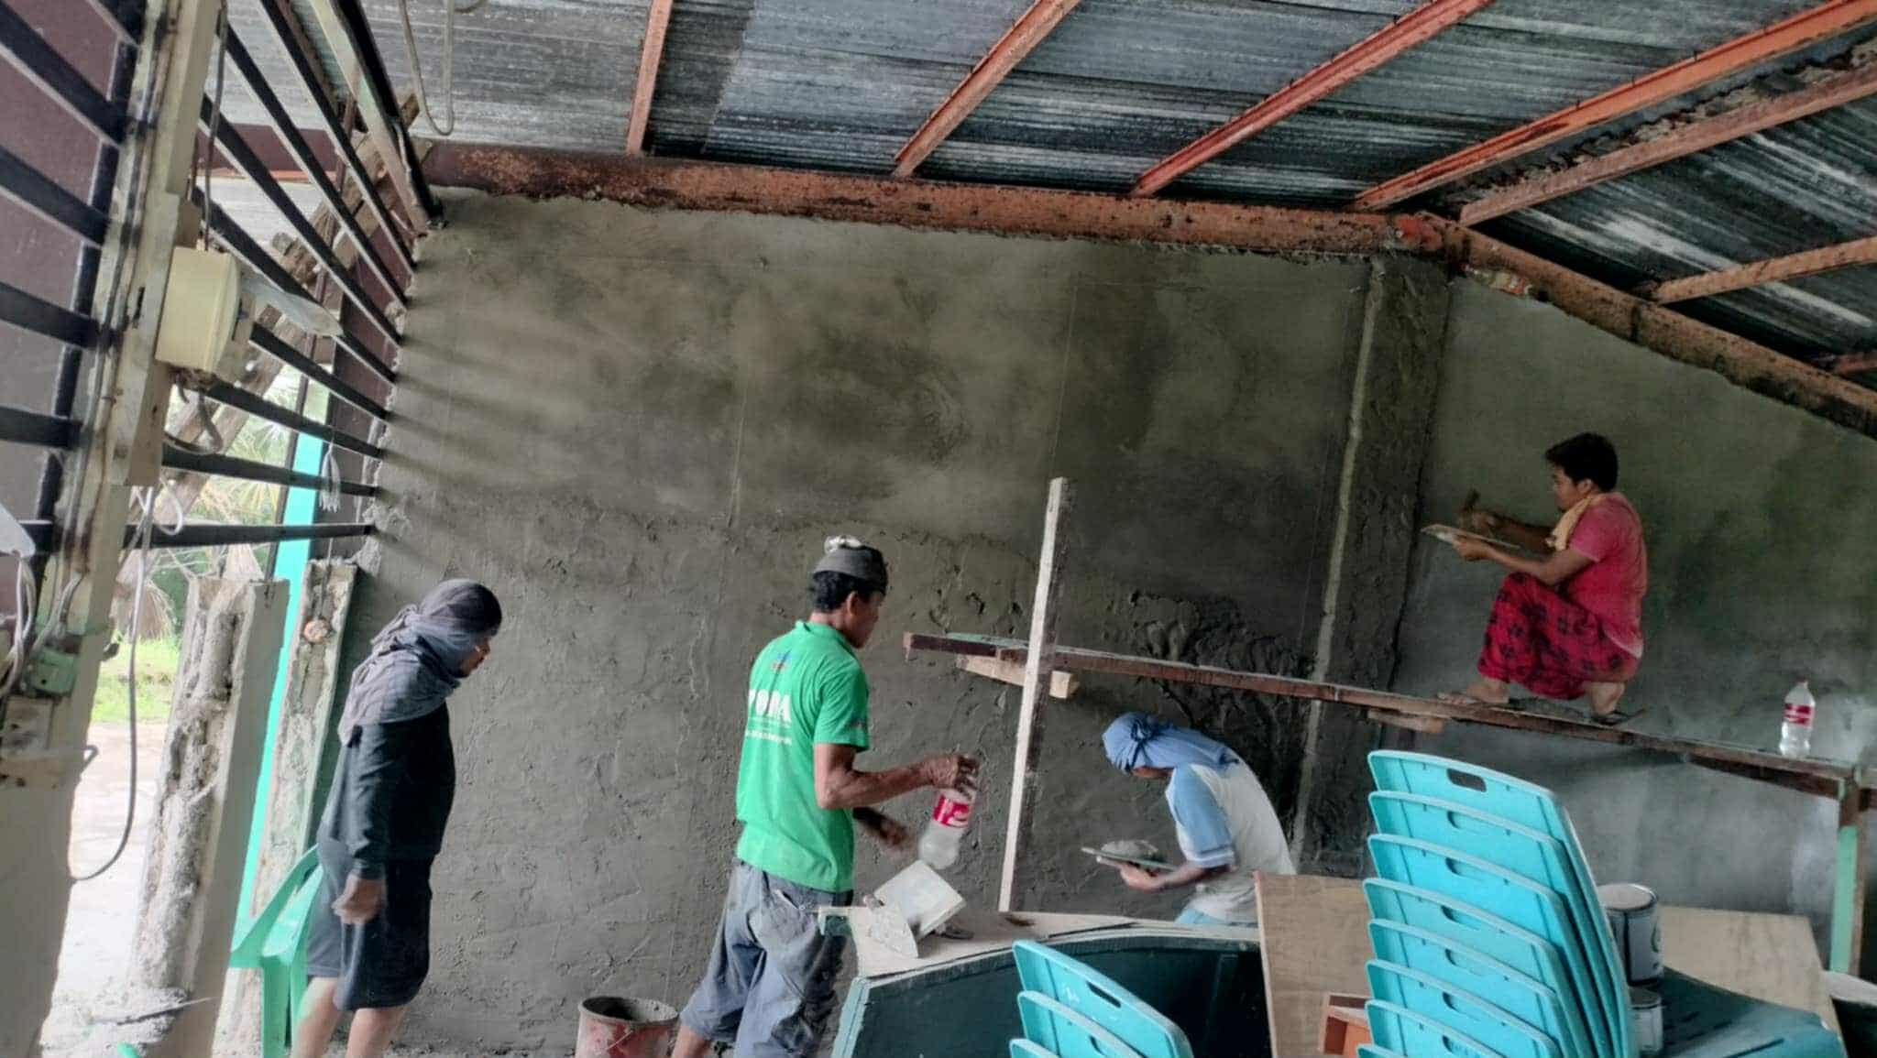

Slide 24
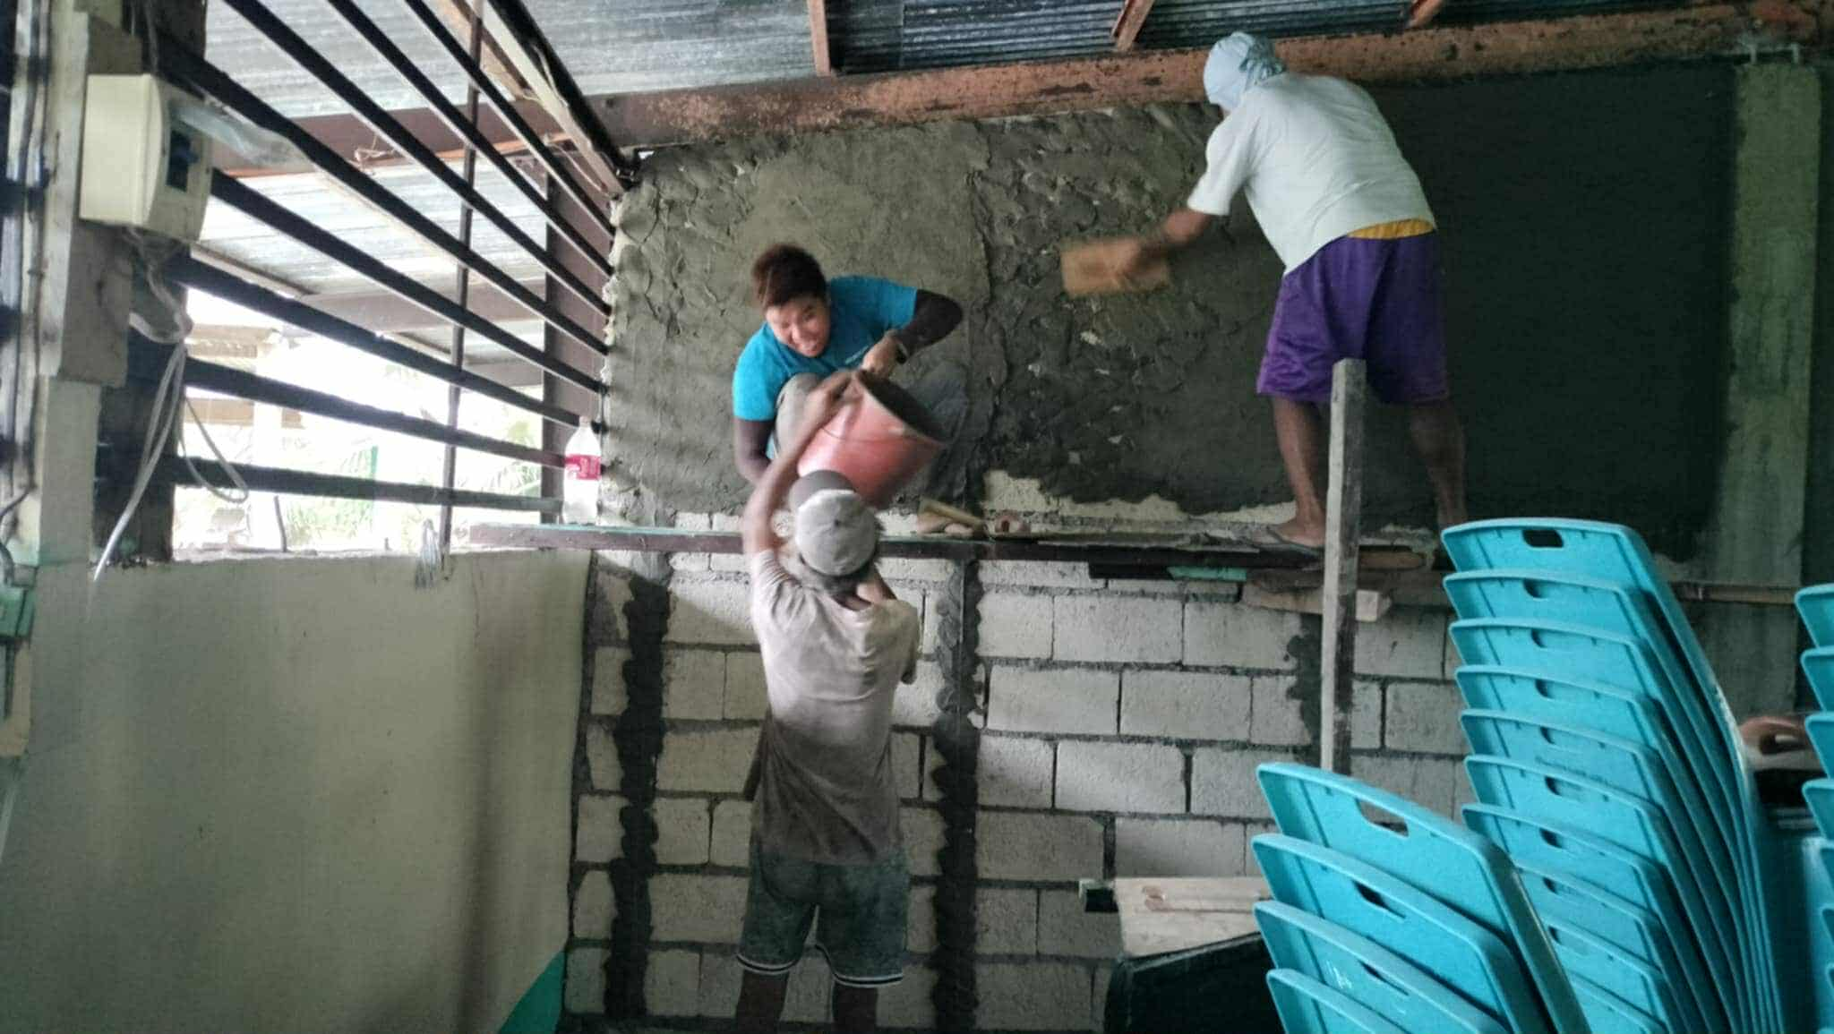

Slide 25
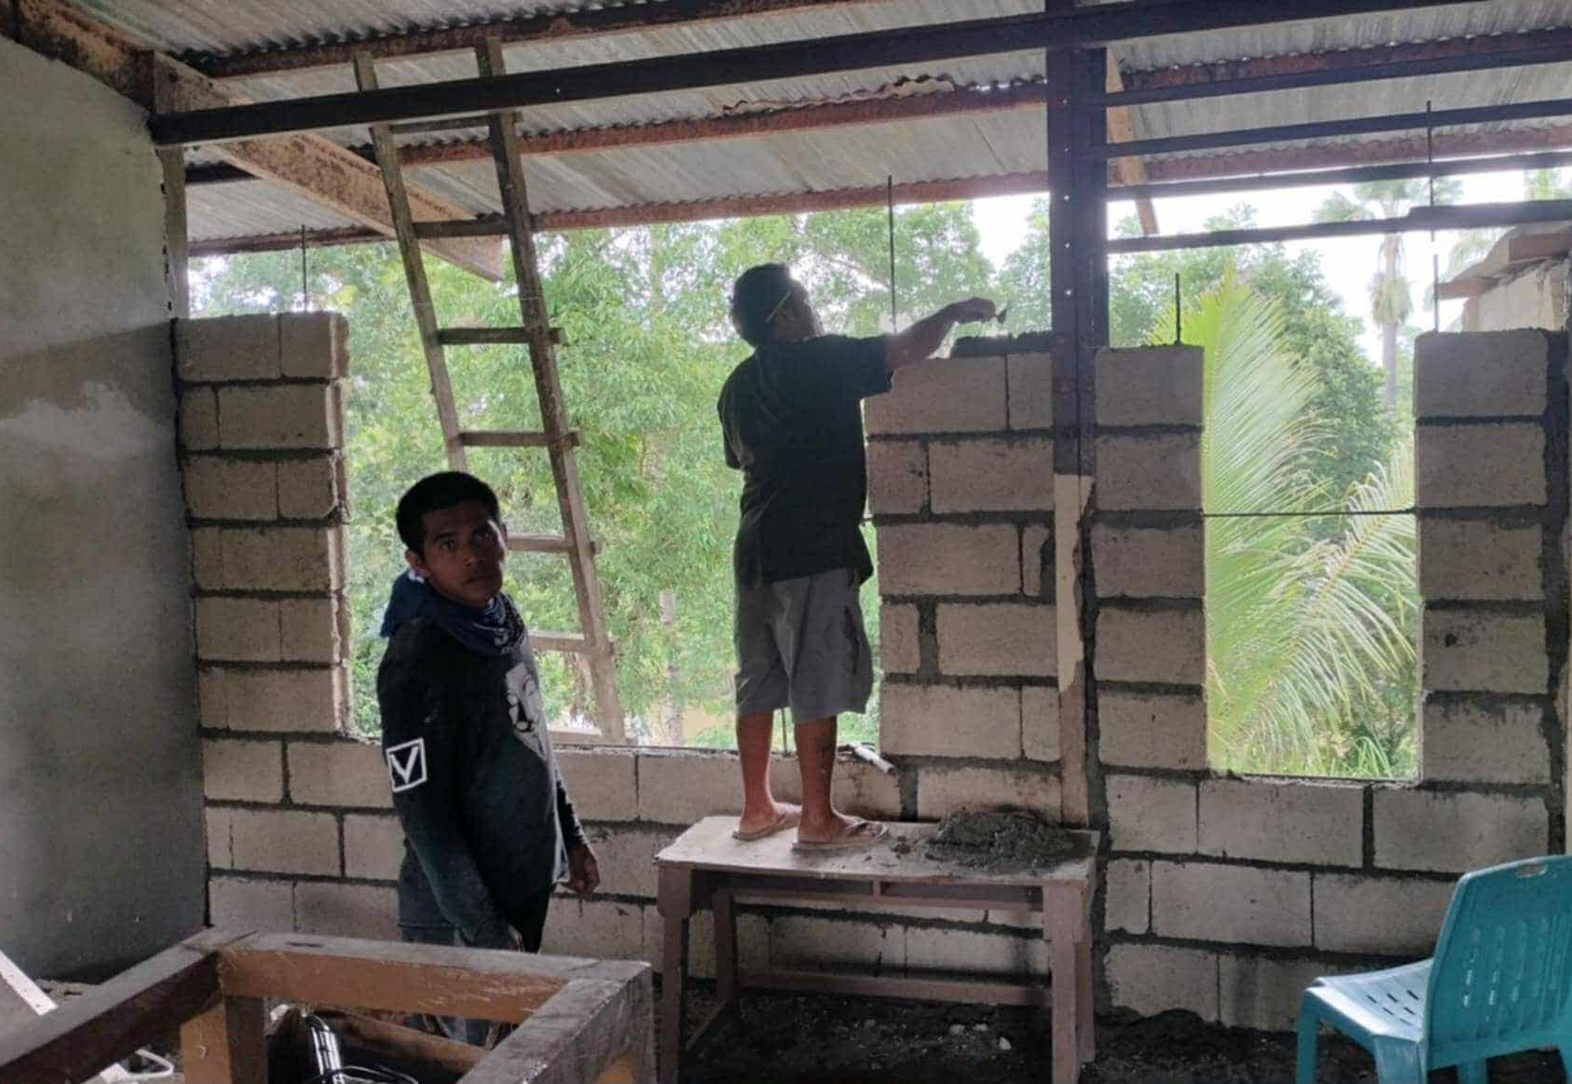

Slide 26
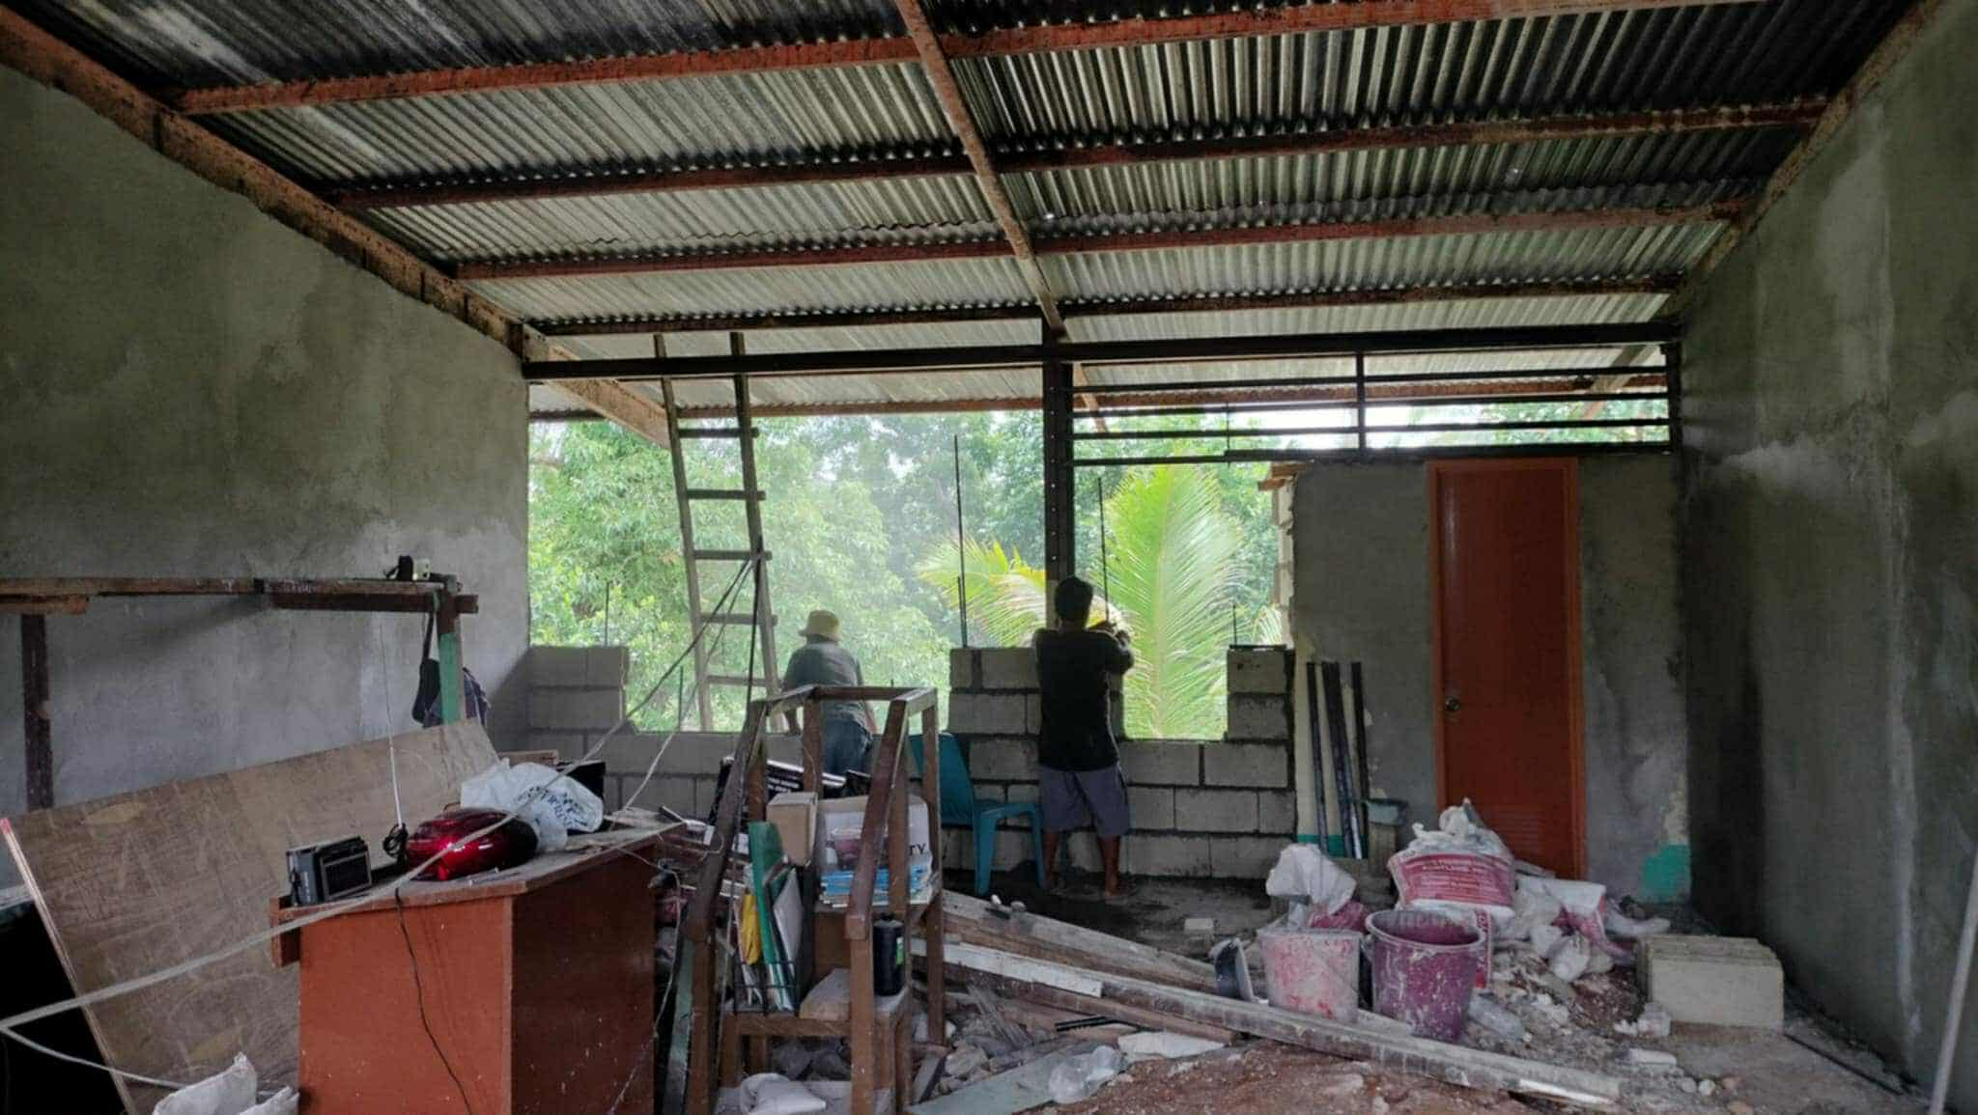

Slide 27
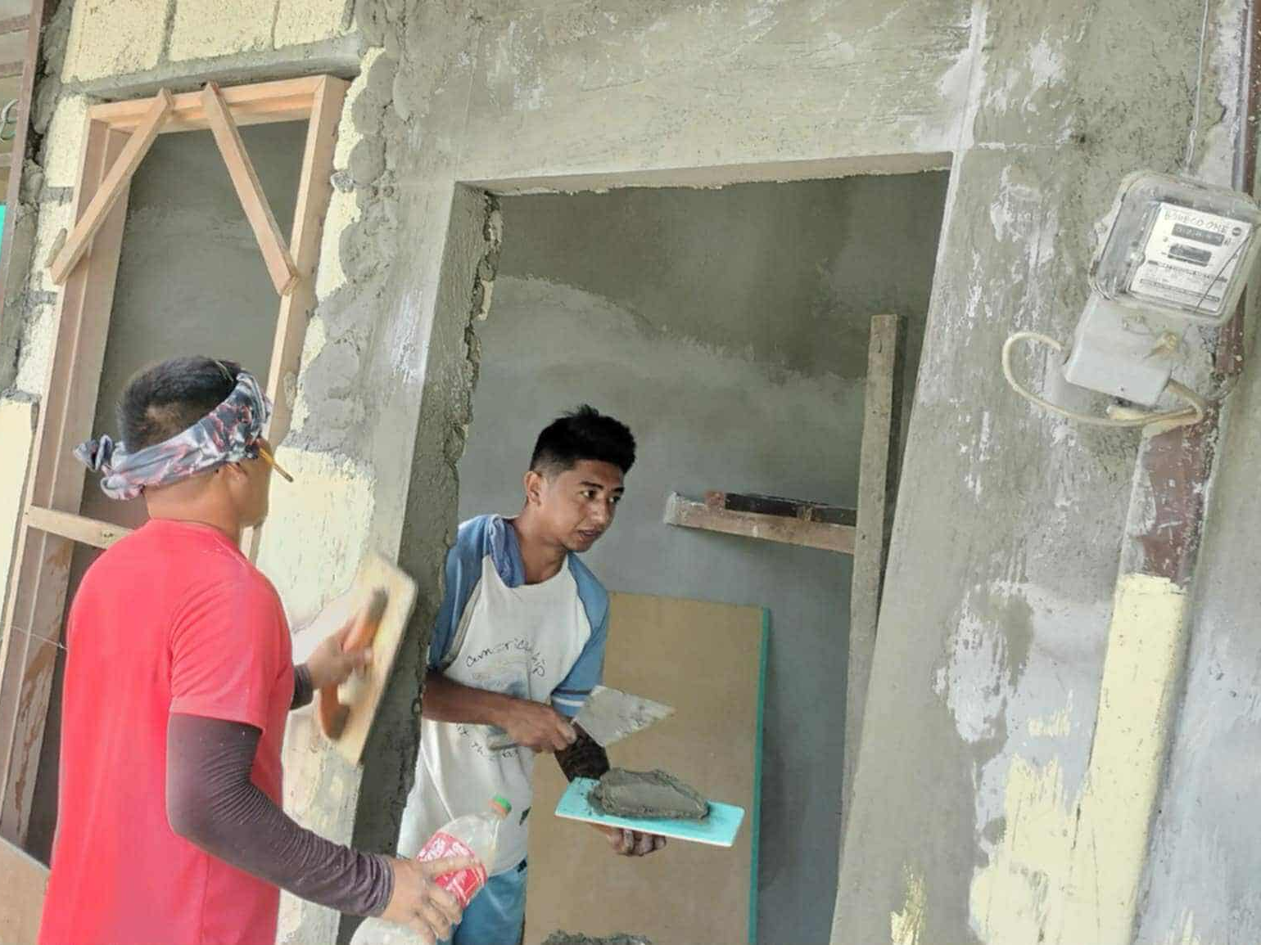

Slide 28
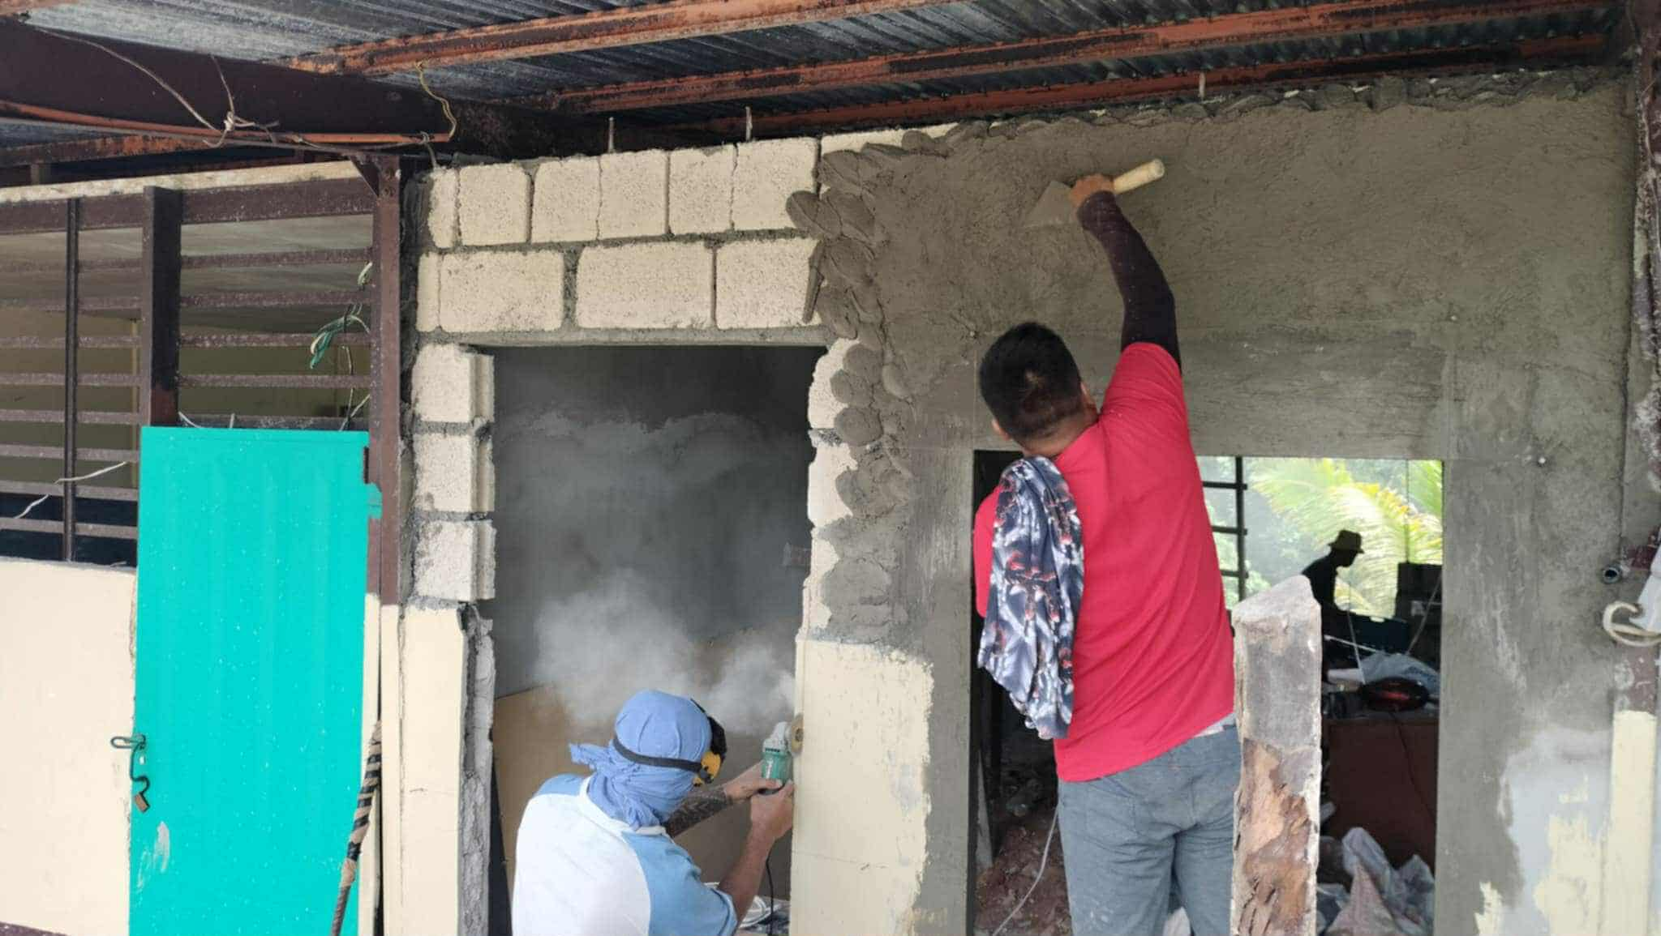

Slide 29
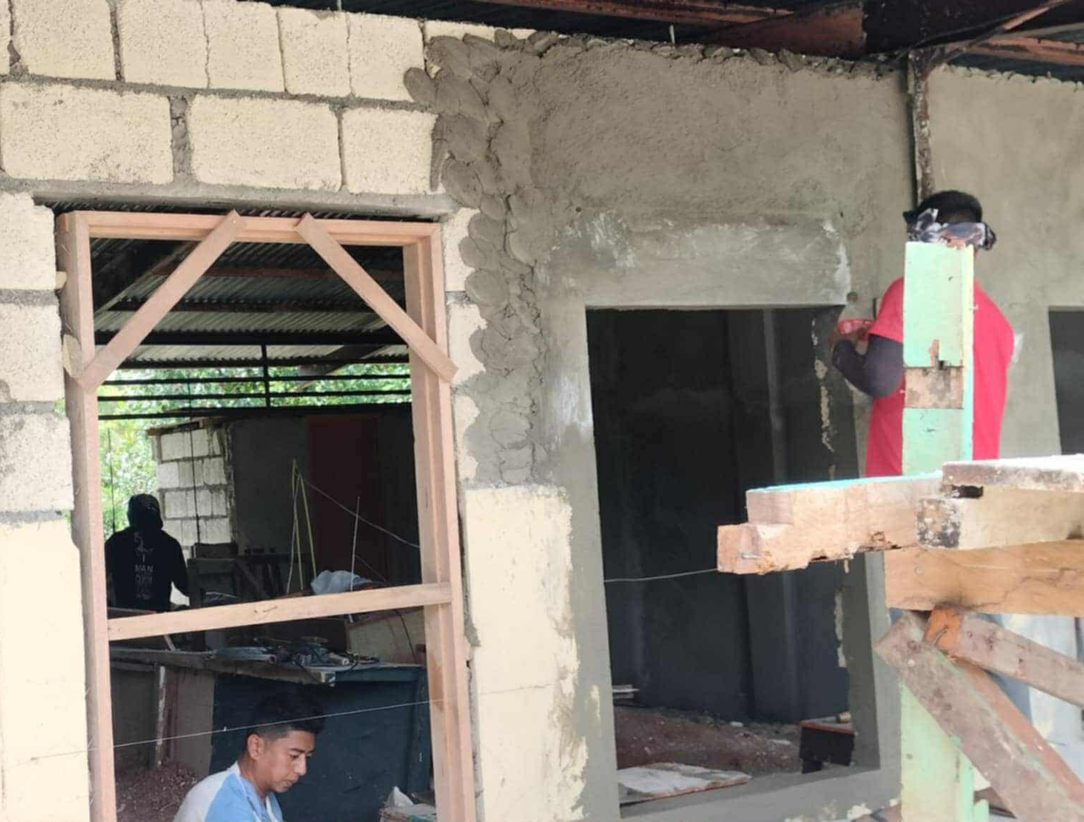

Slide 30
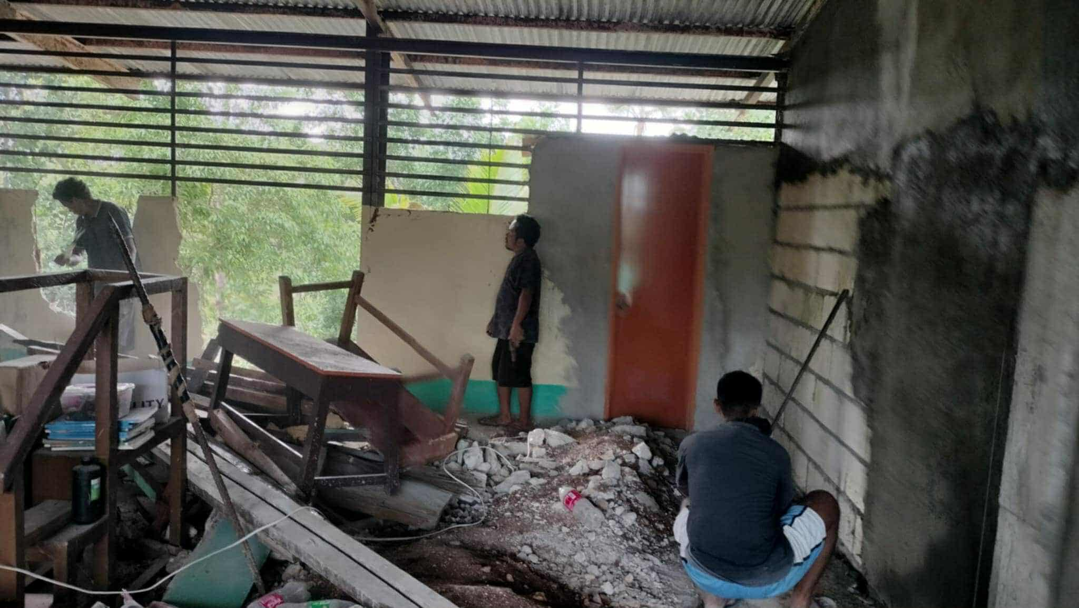

Slide 31
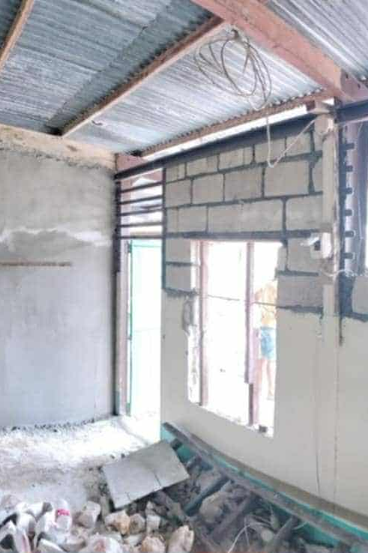
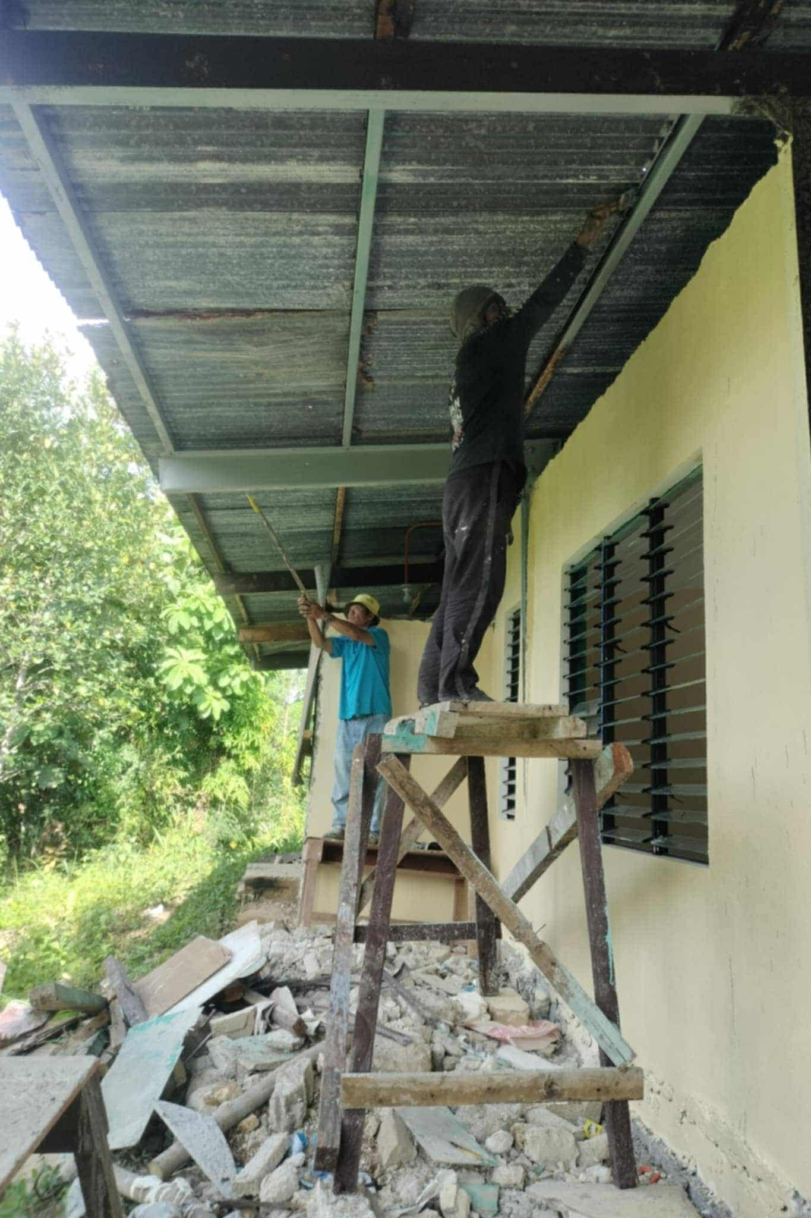

Slide 32
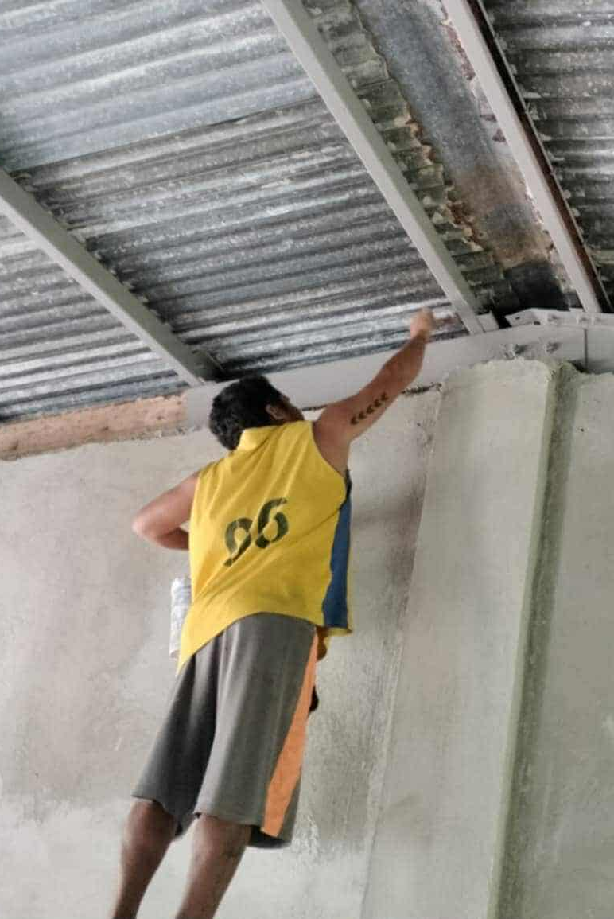
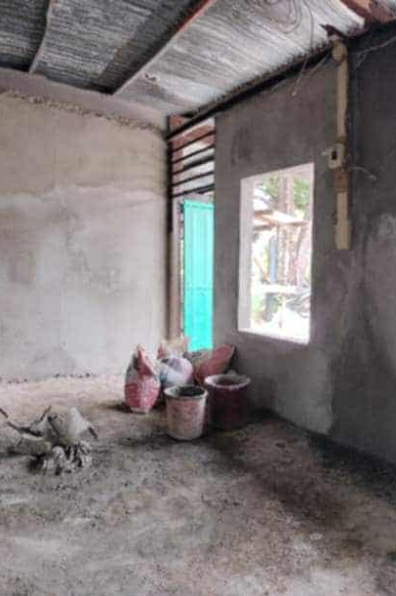

Slide 33
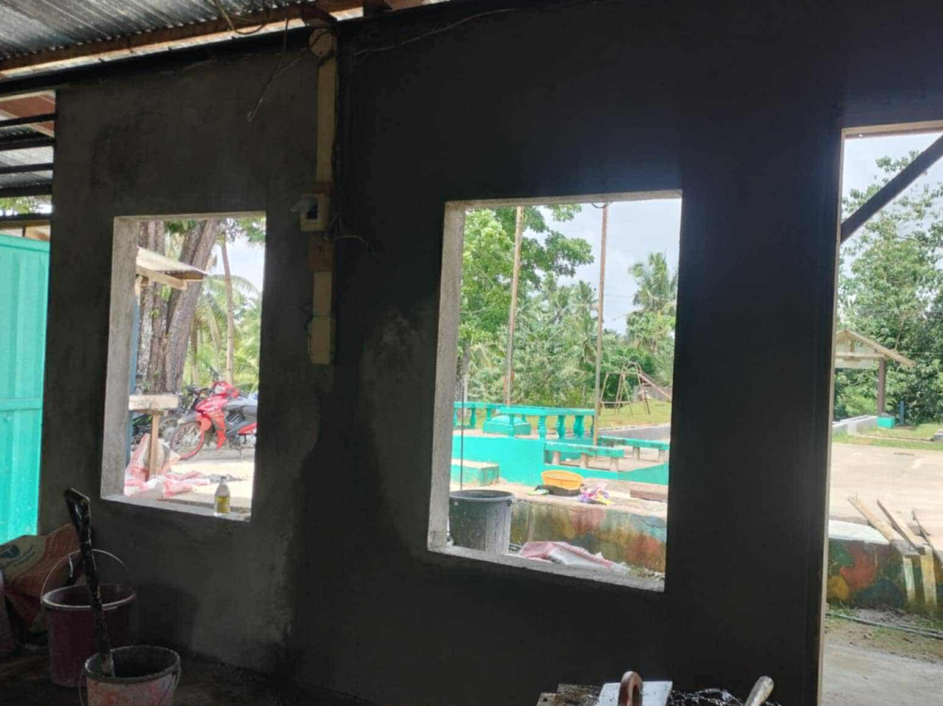

Slide 34
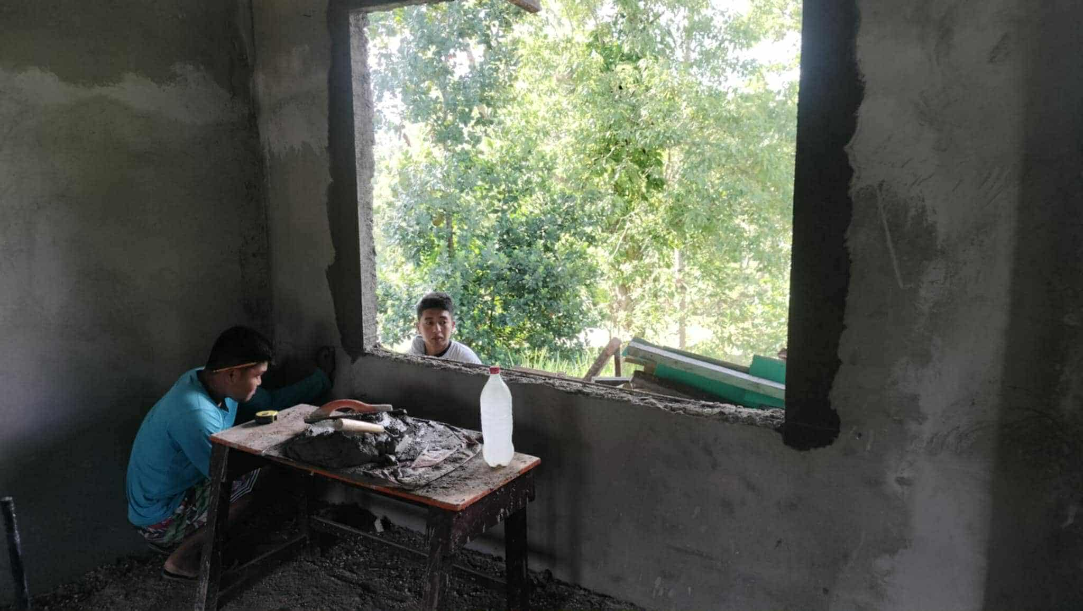

Slide 35
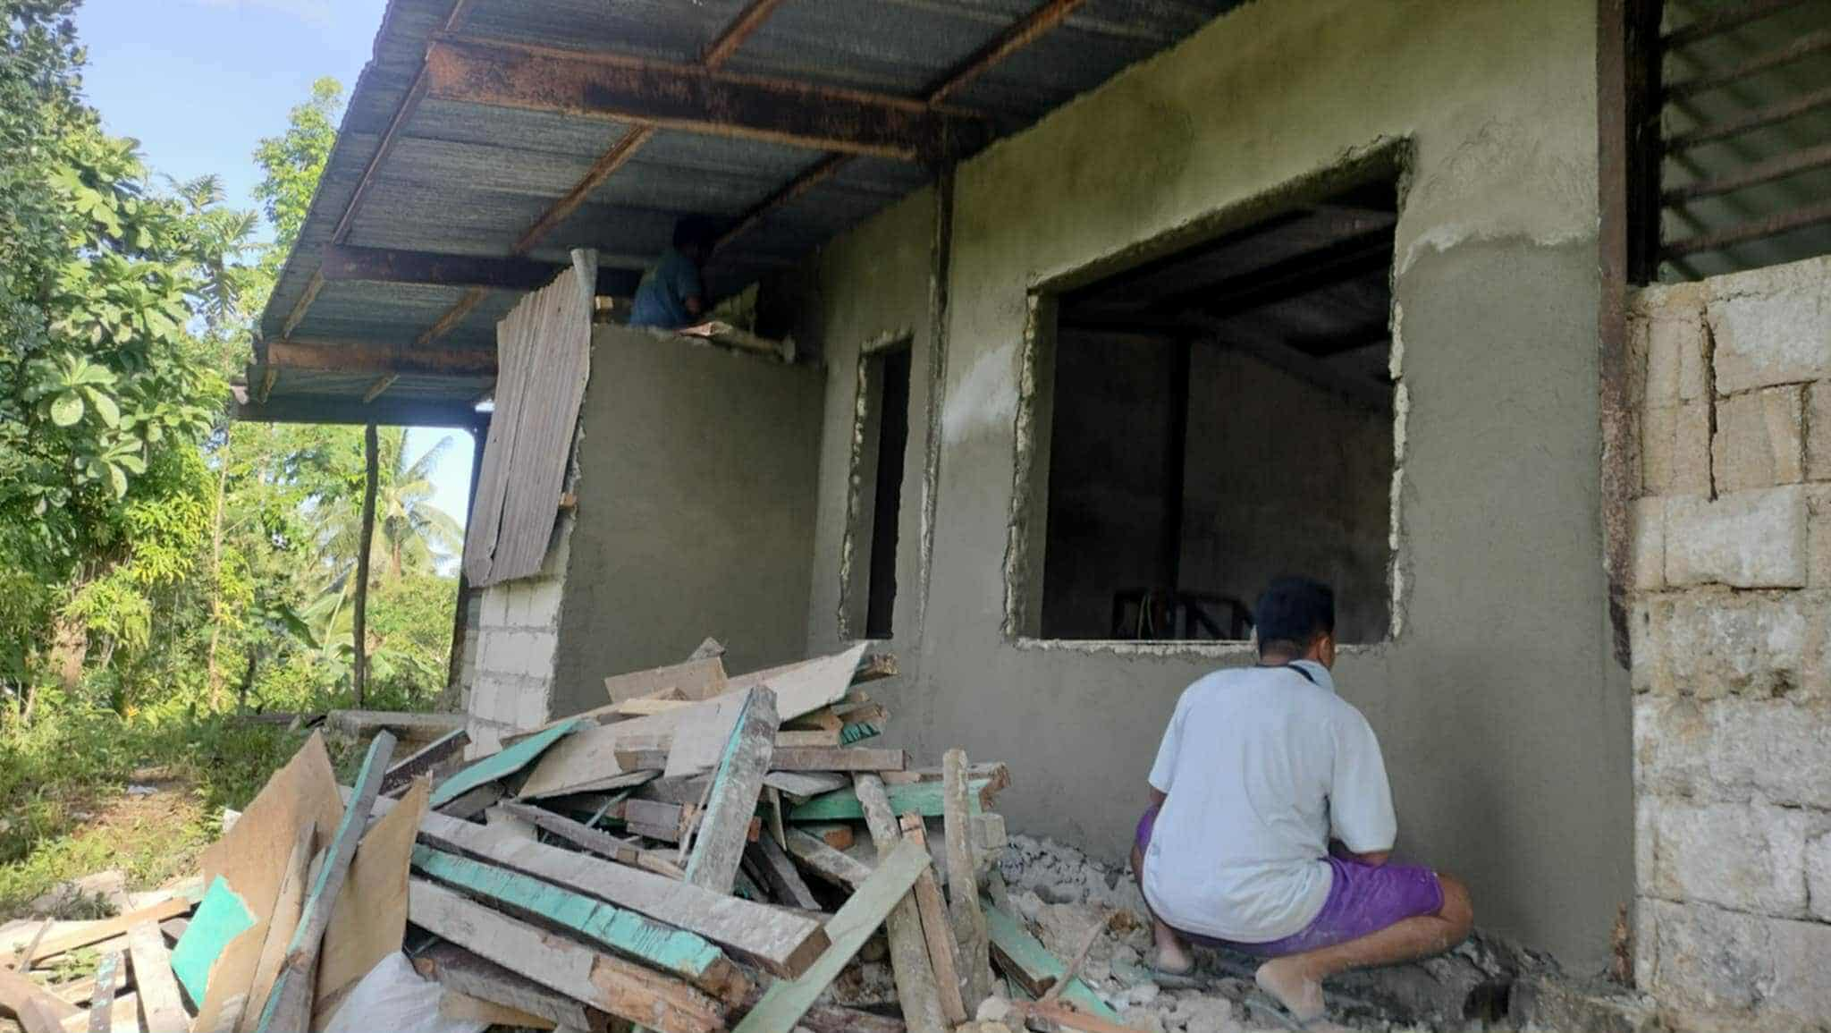

Slide 36
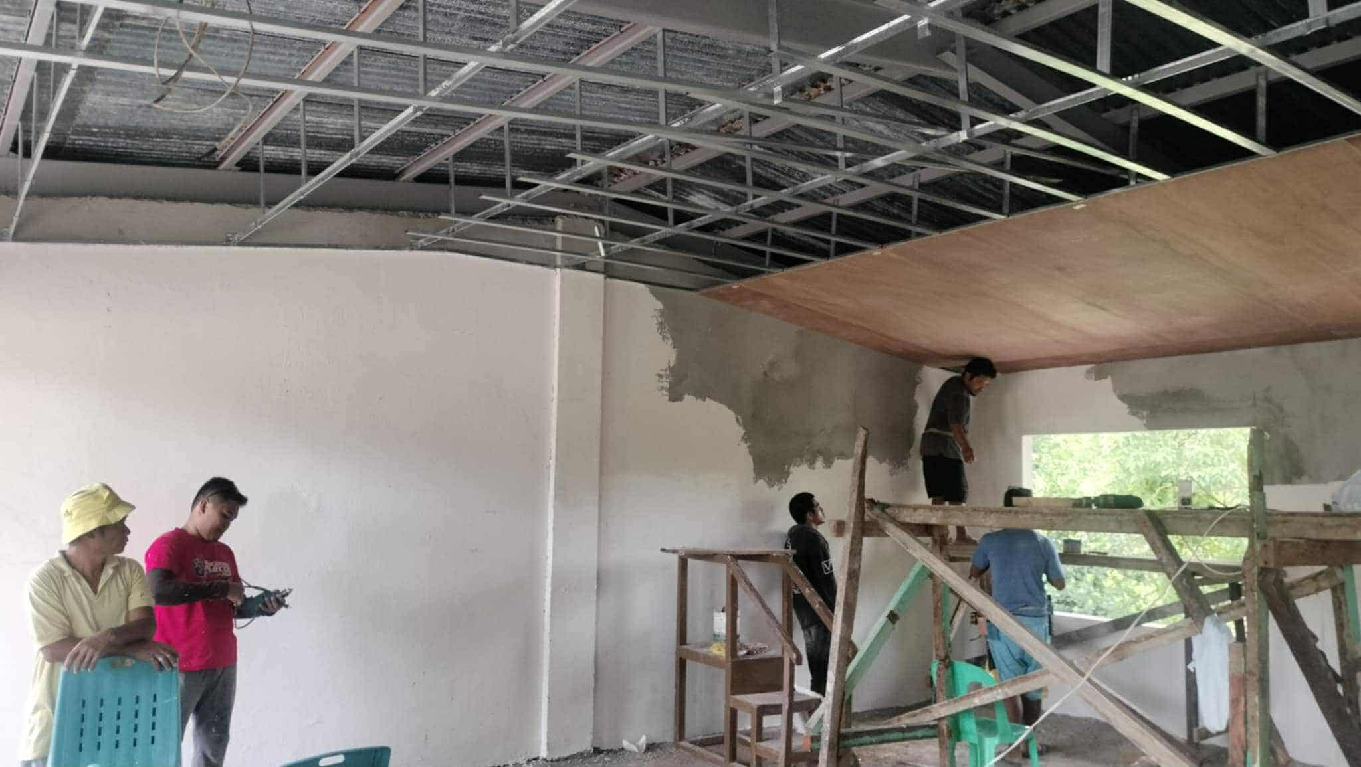

Slide 37
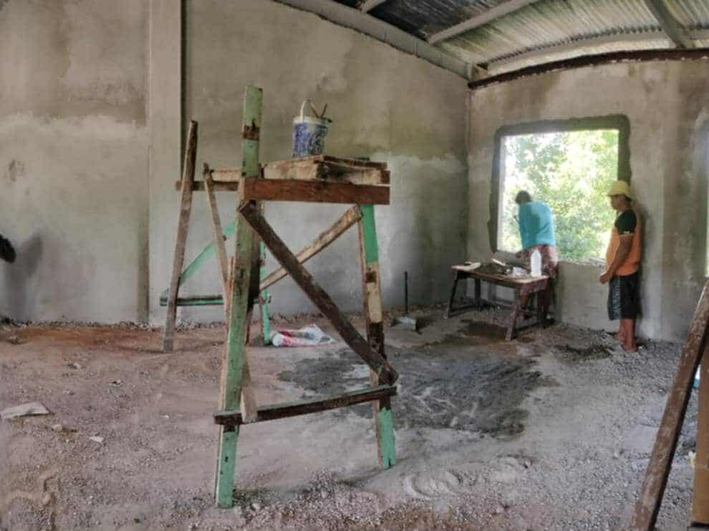

Slide 38
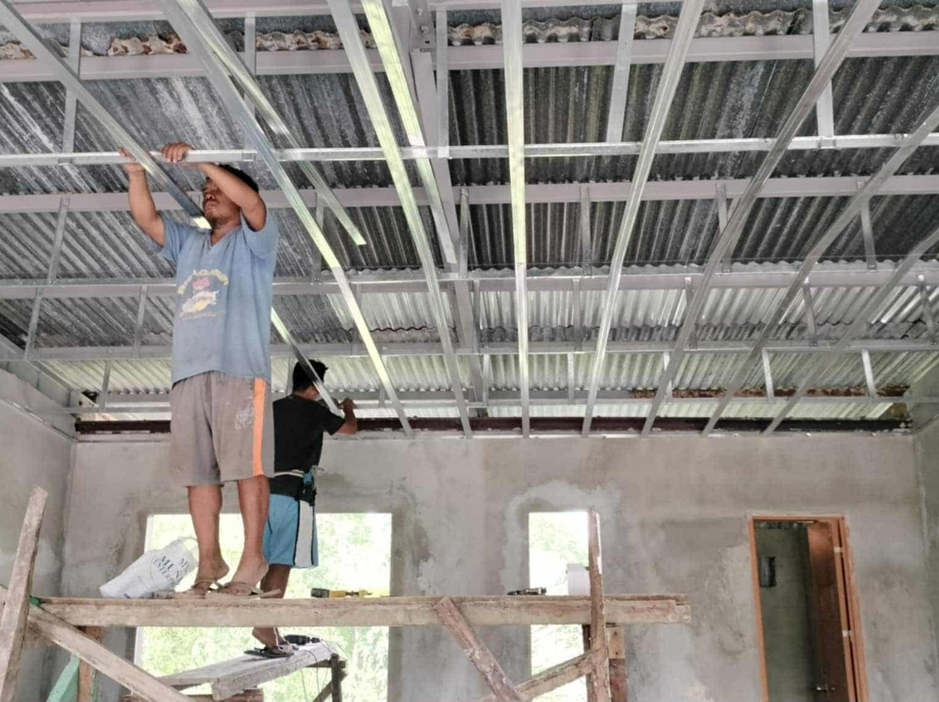

Slide 39
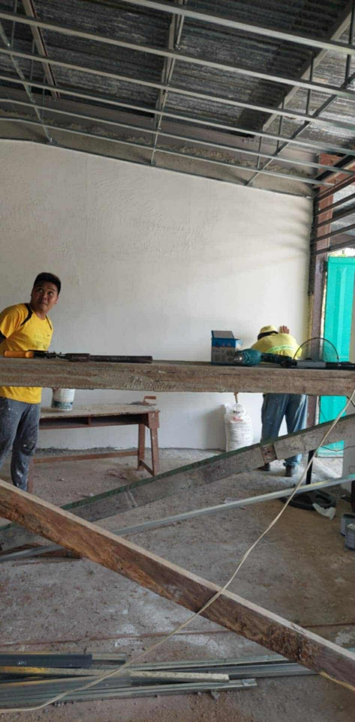
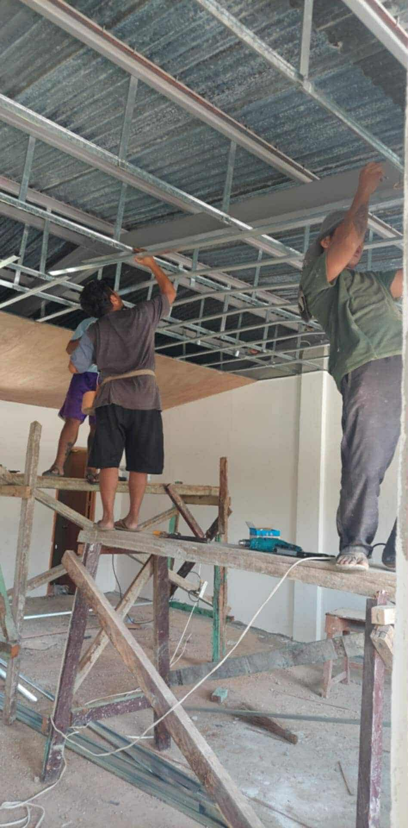

Slide 40
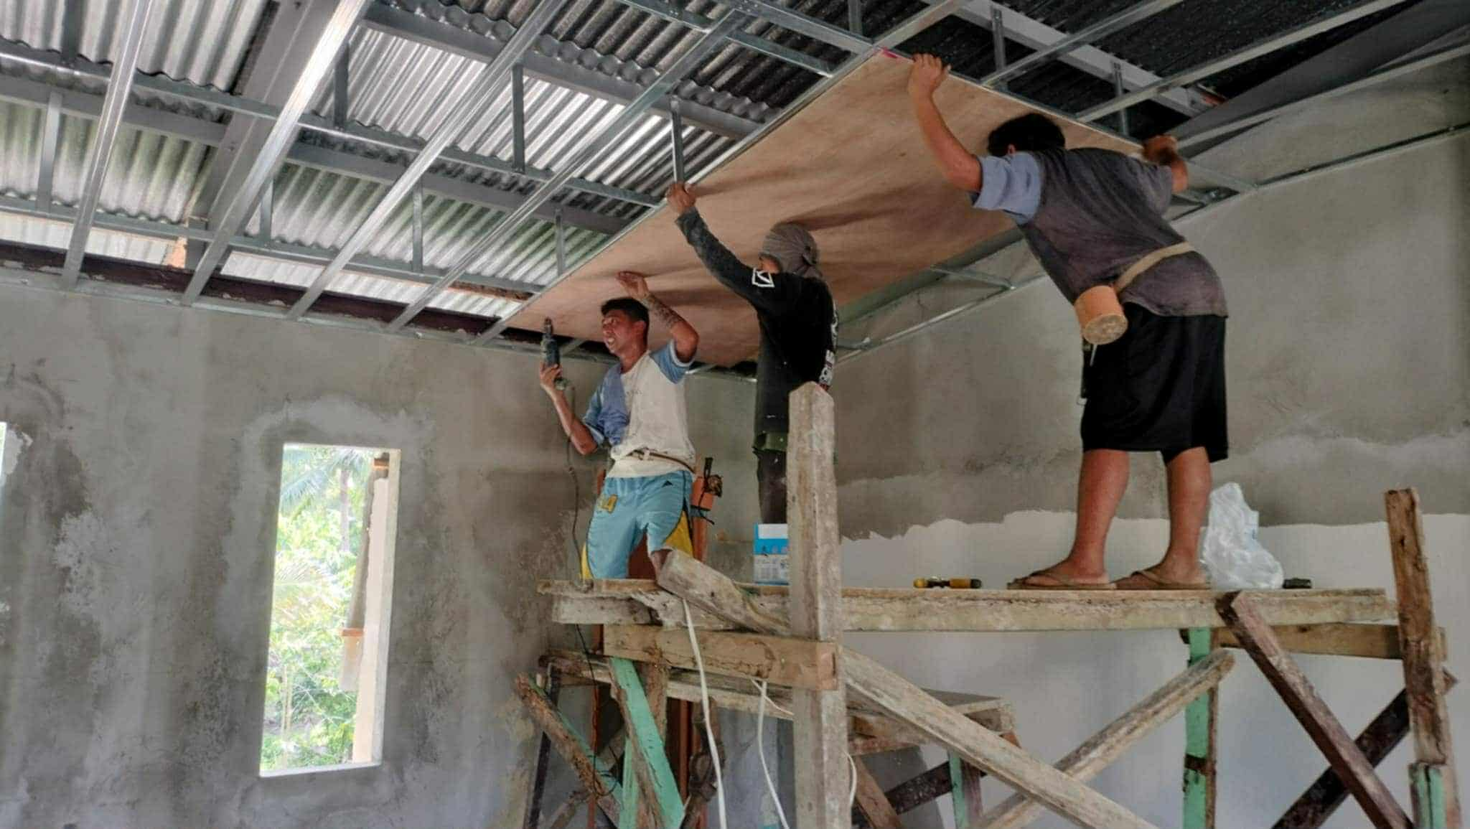

Slide 41
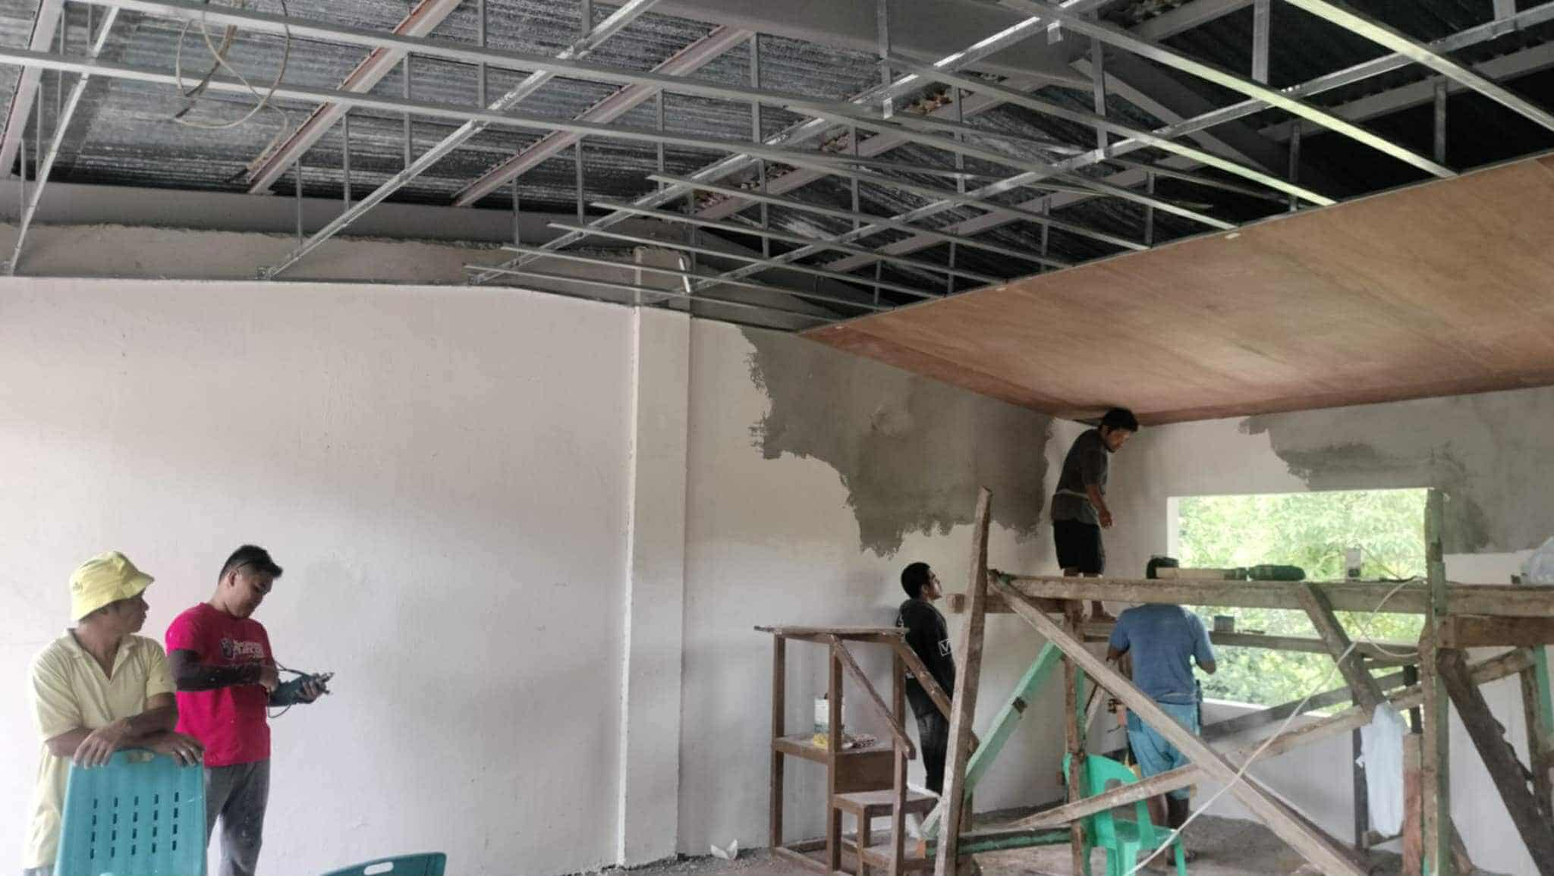

Slide 42
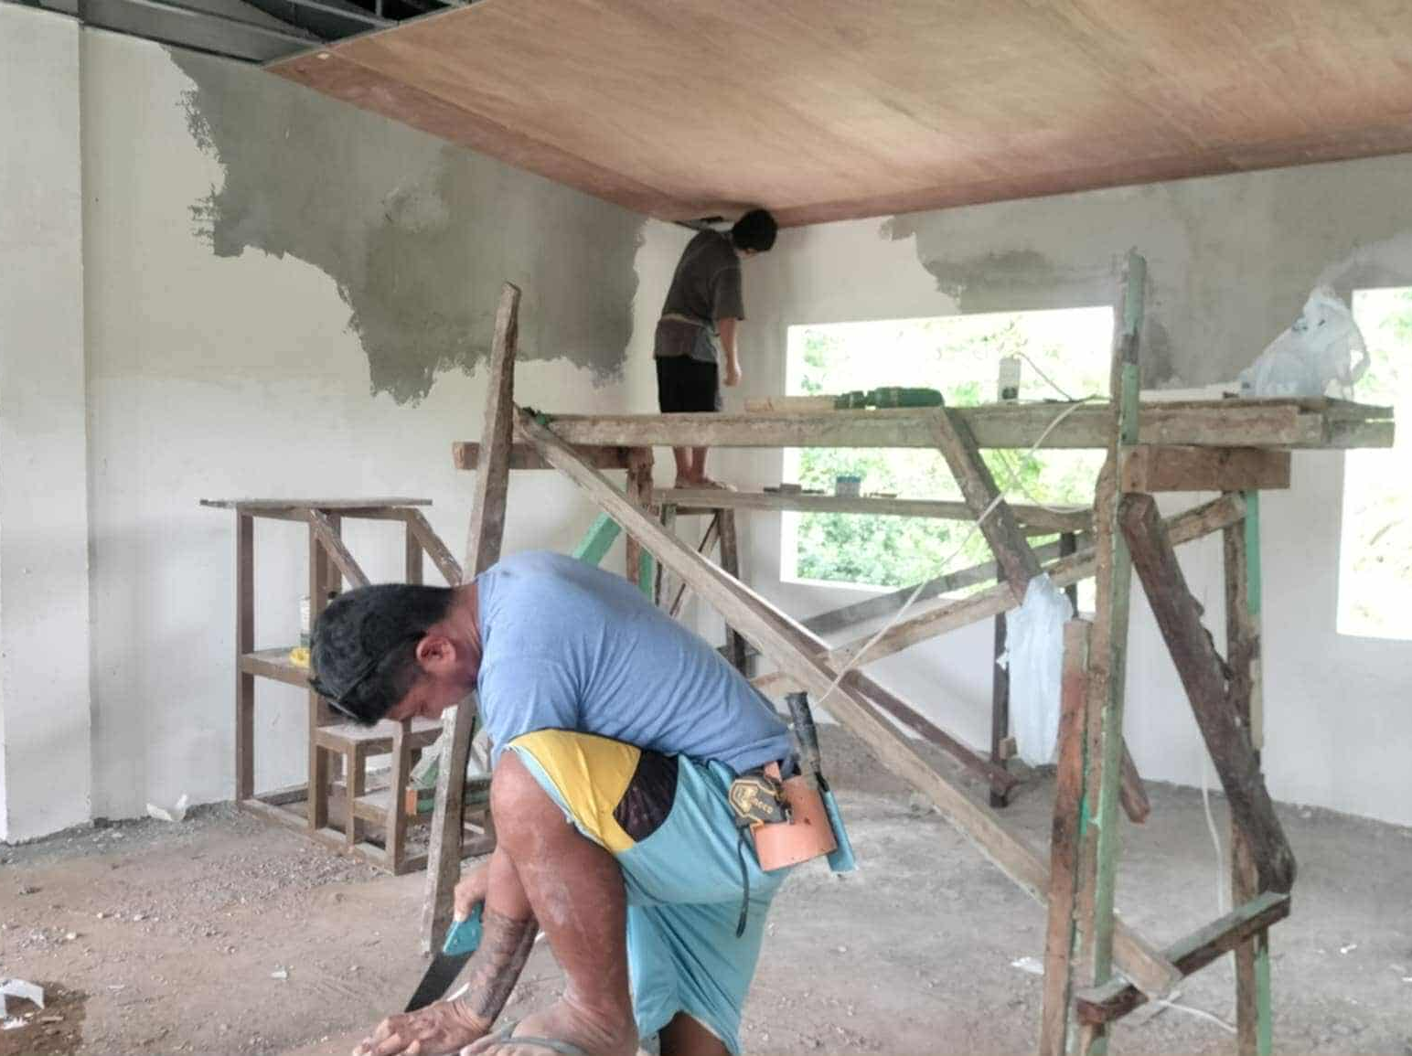

Slide 43
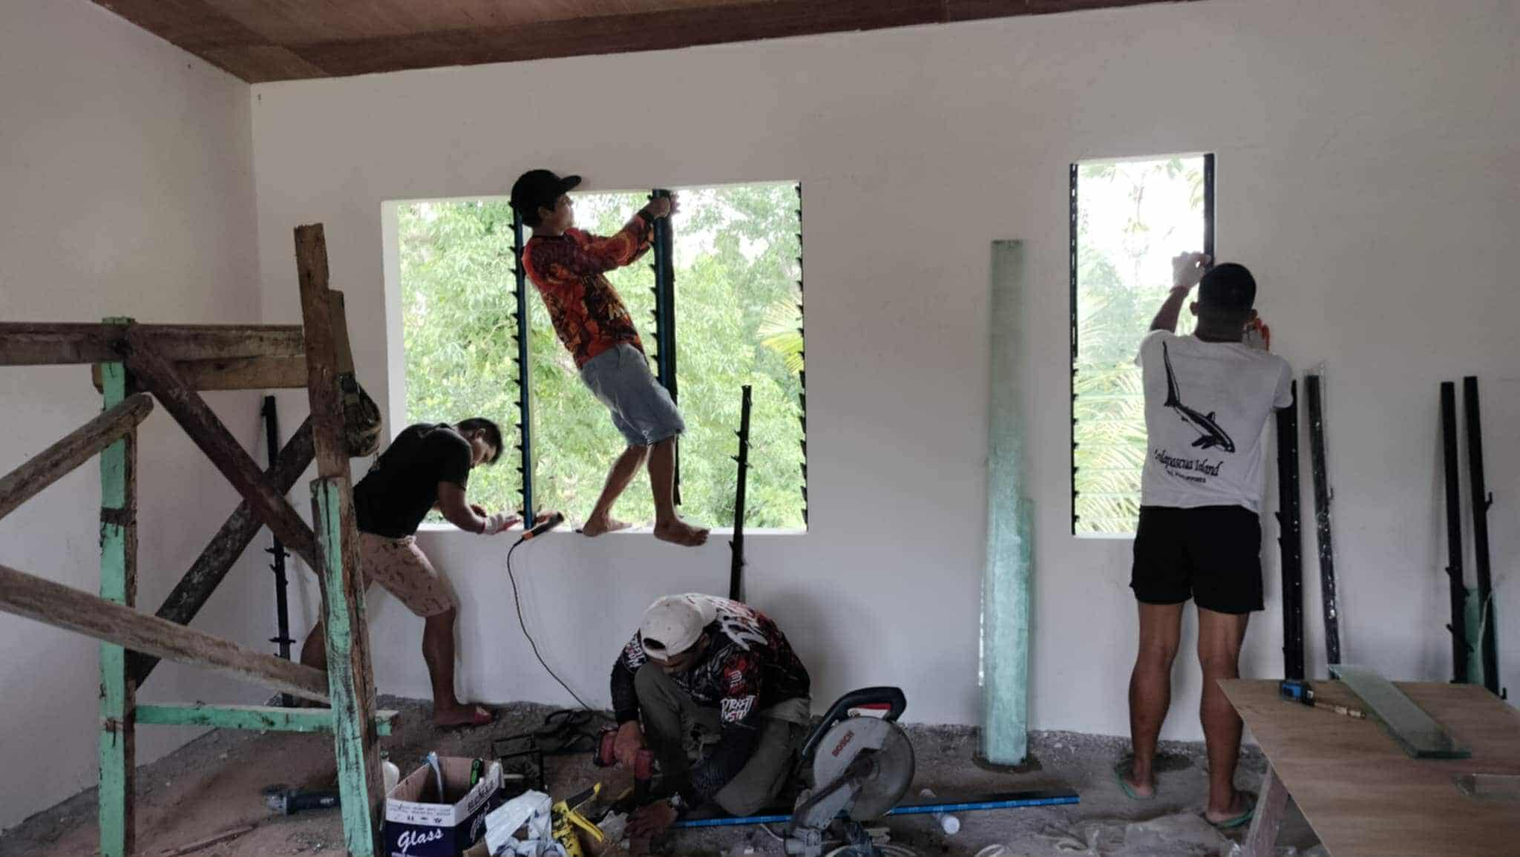

Slide 44
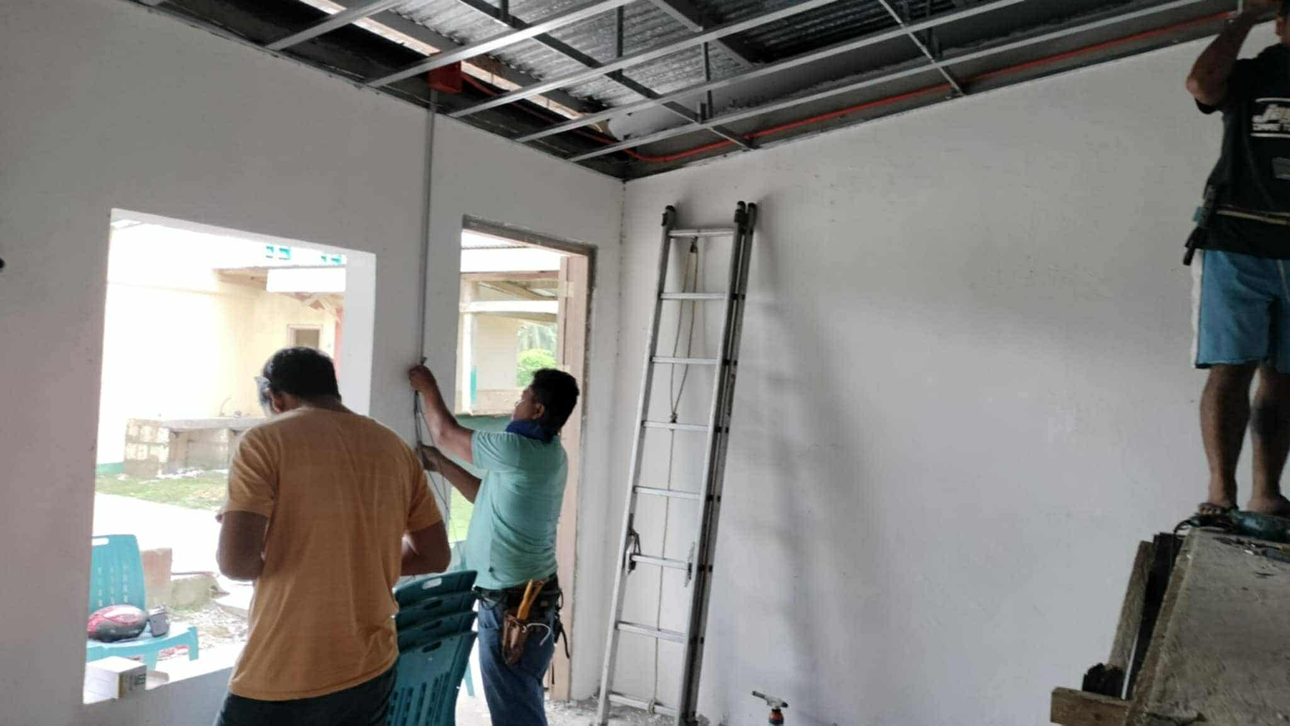

Slide 45
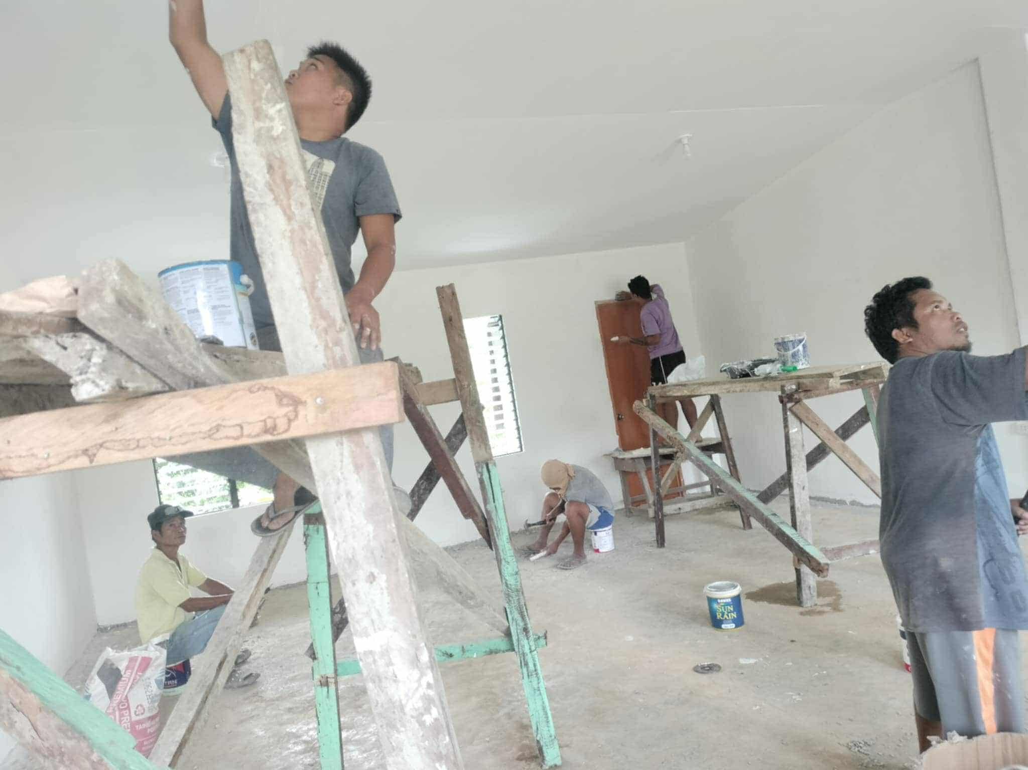

Slide 46
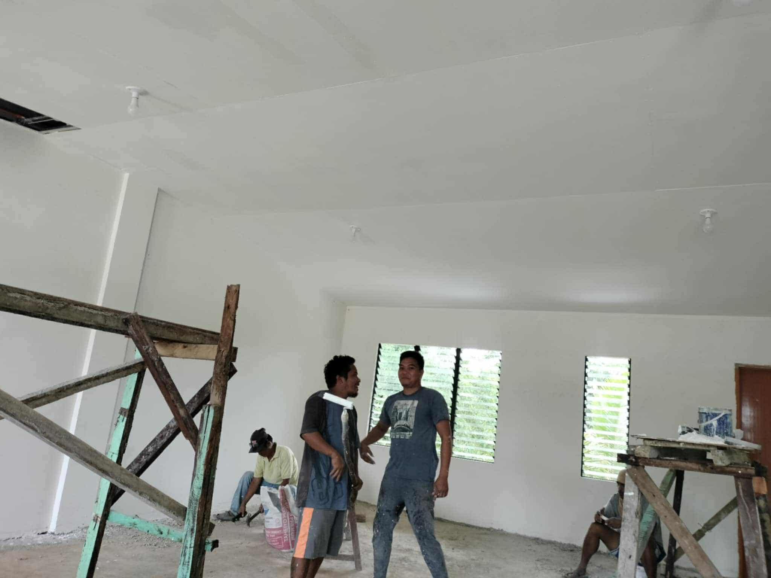

Slide 47
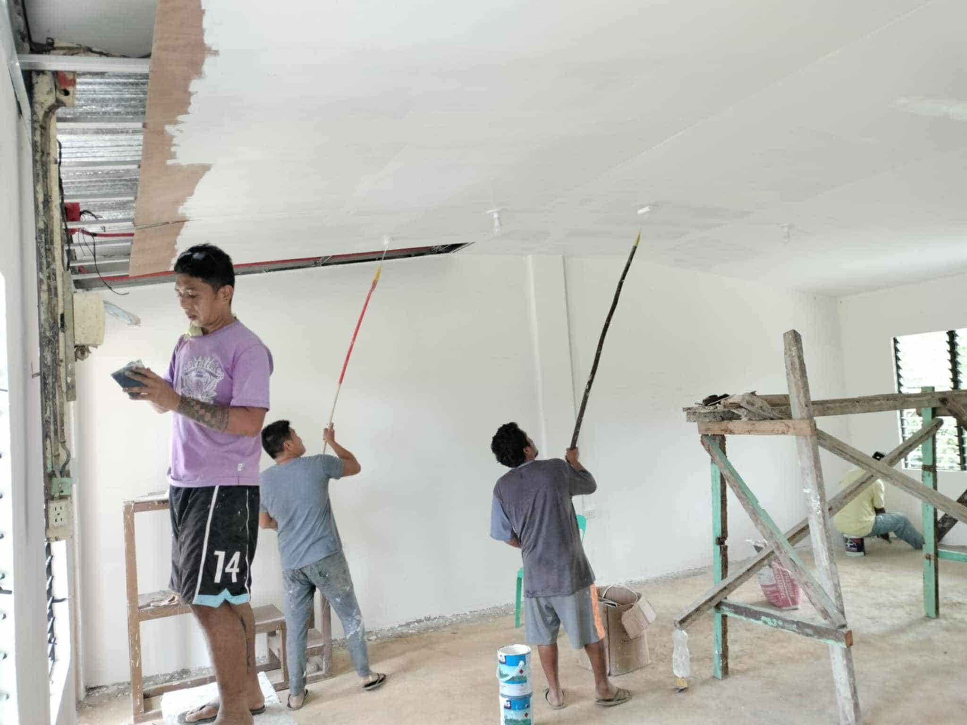

Slide 48
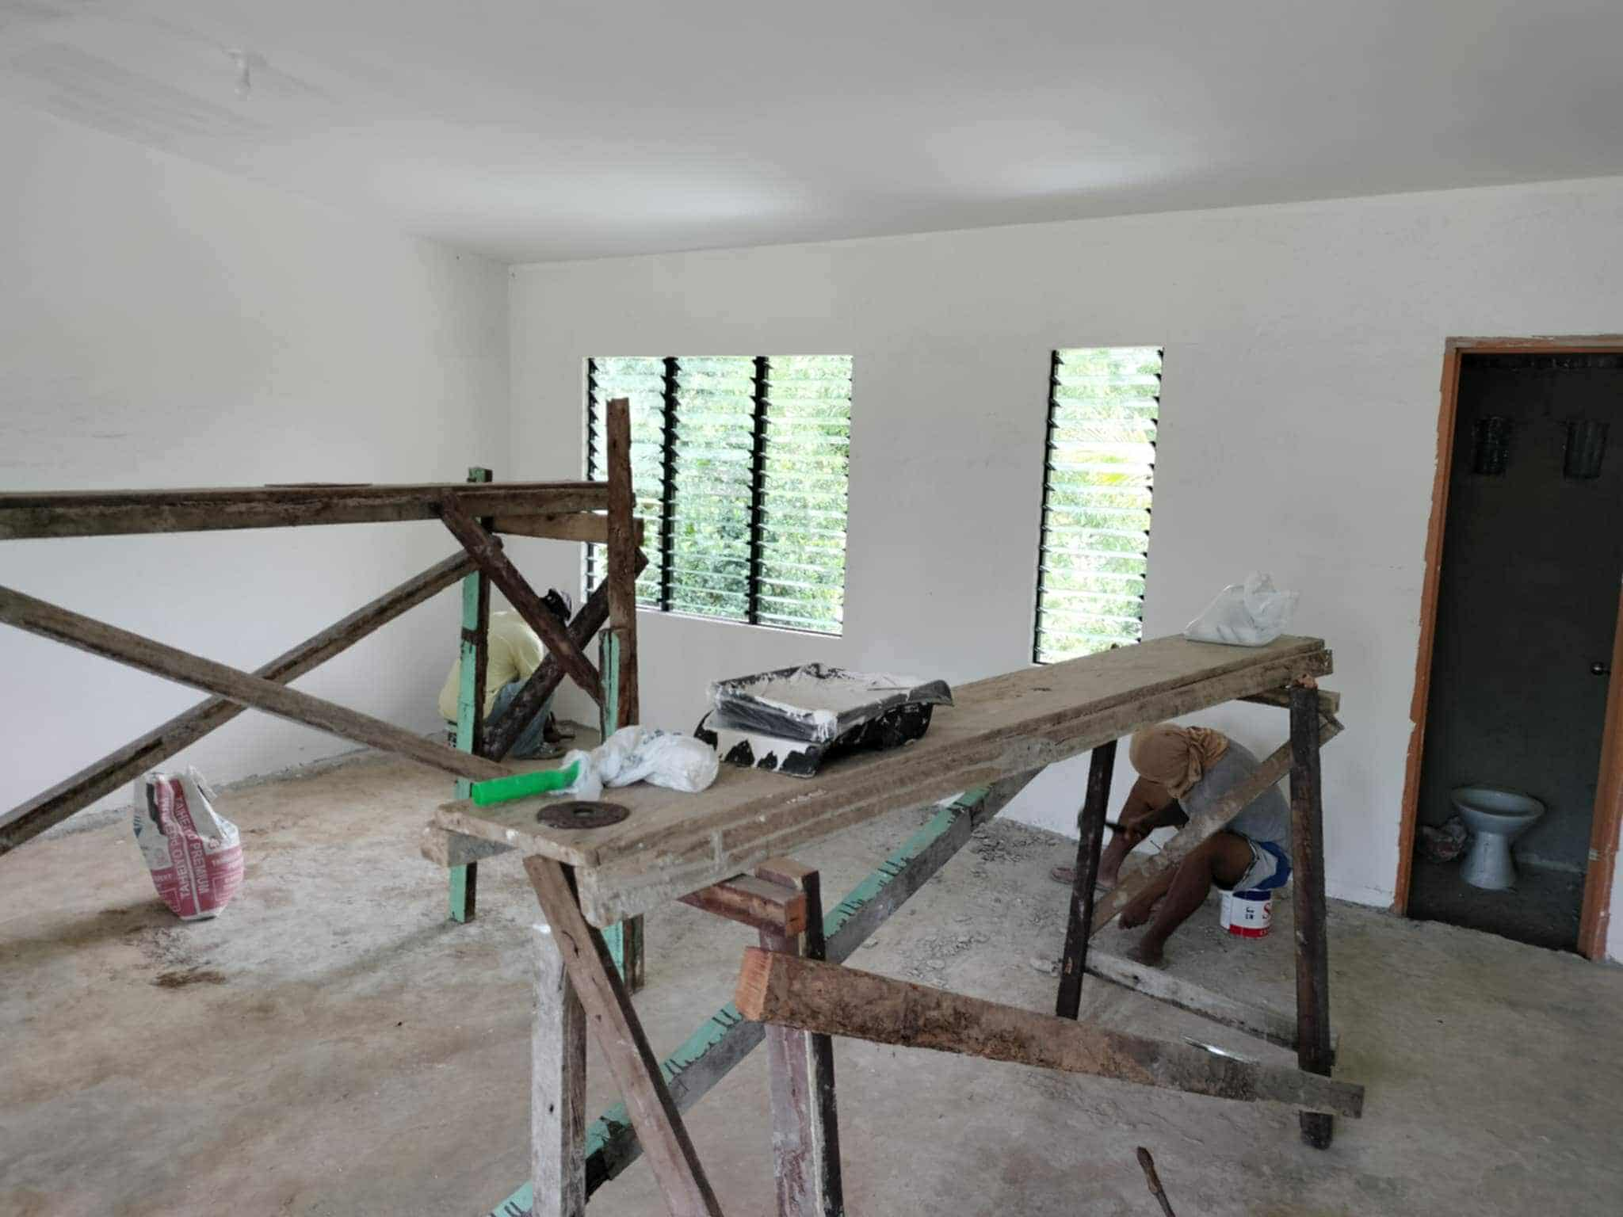

Slide 49
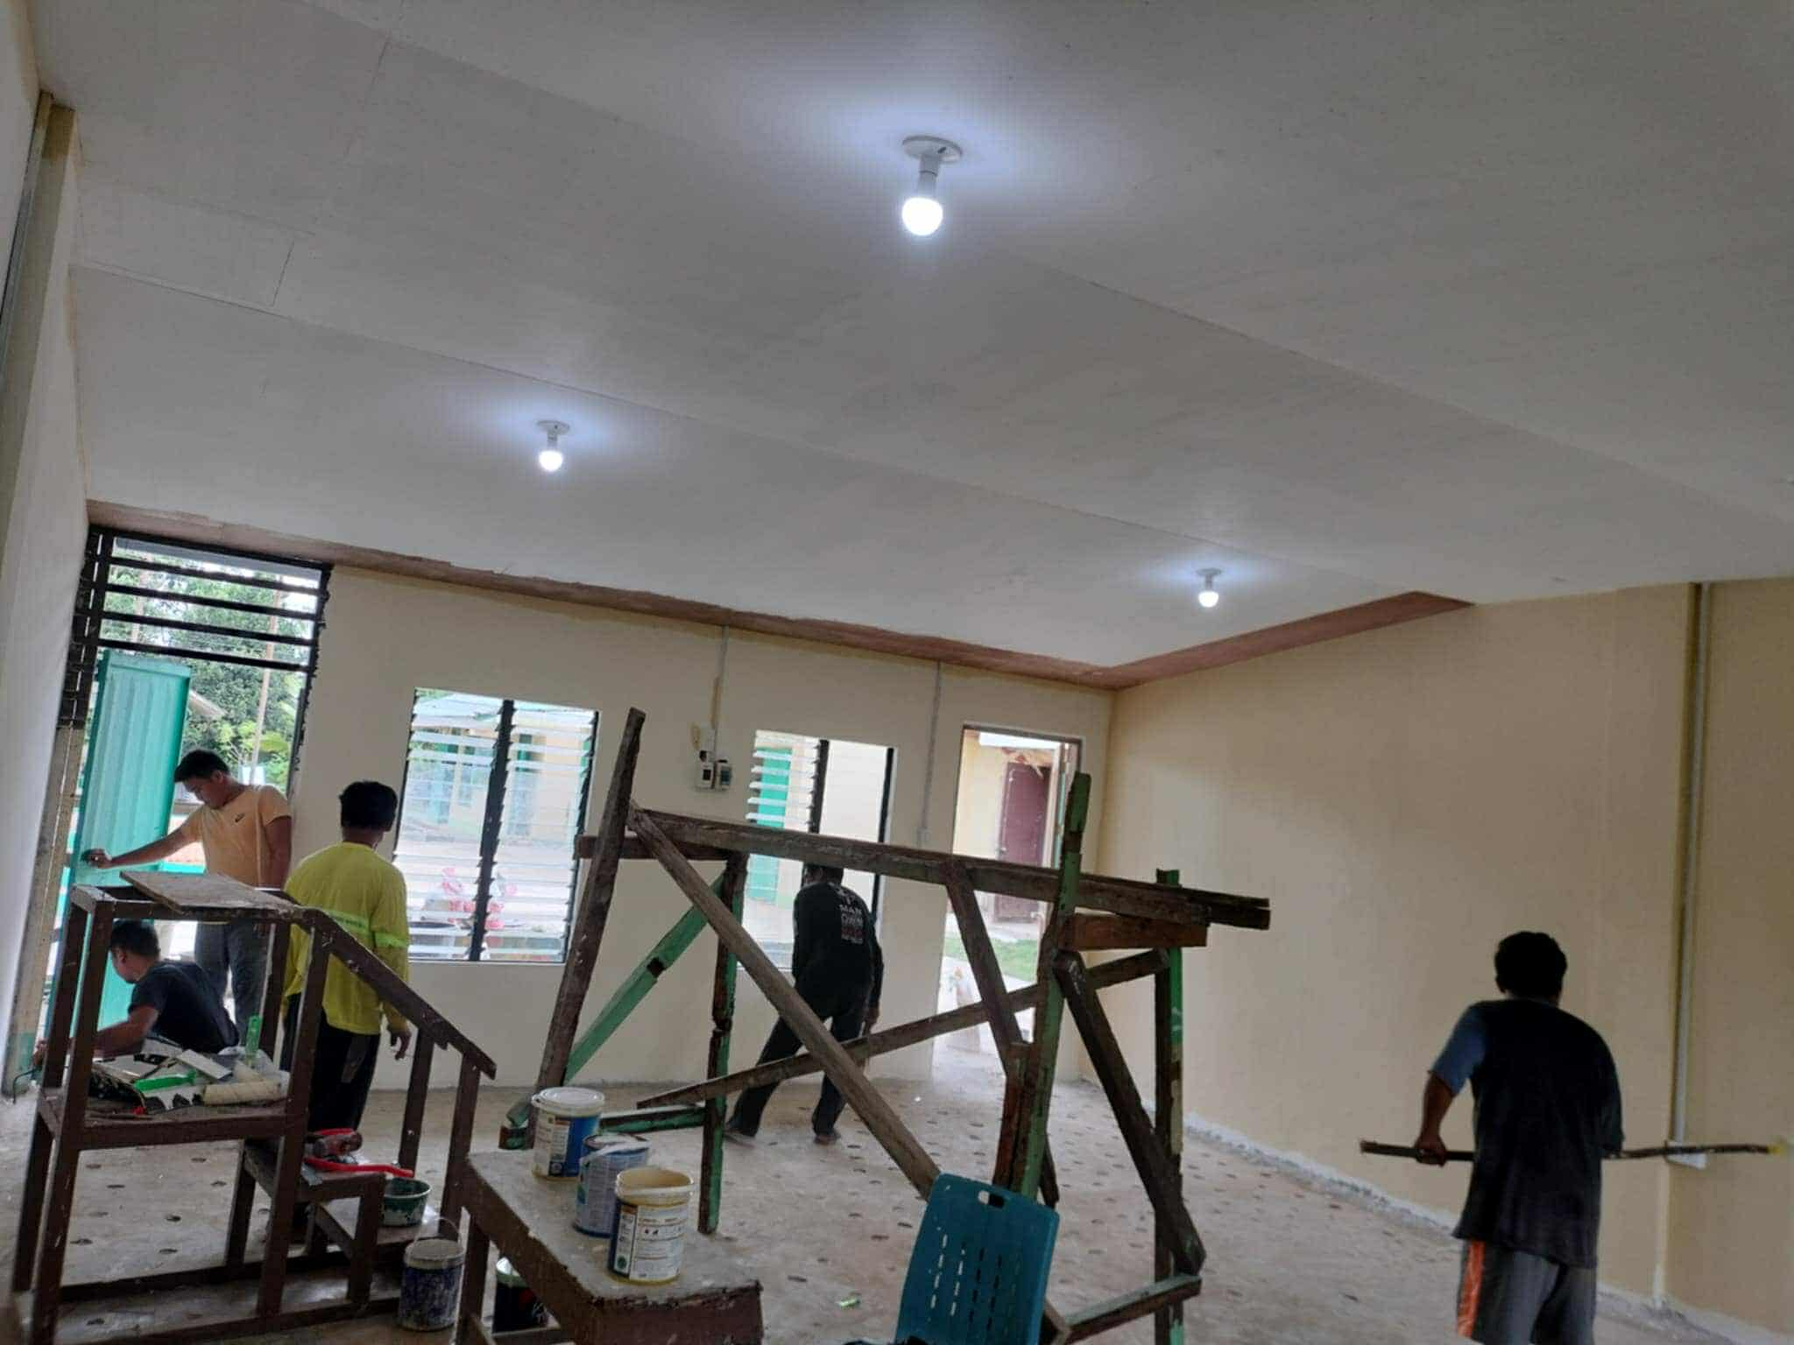

Slide 50
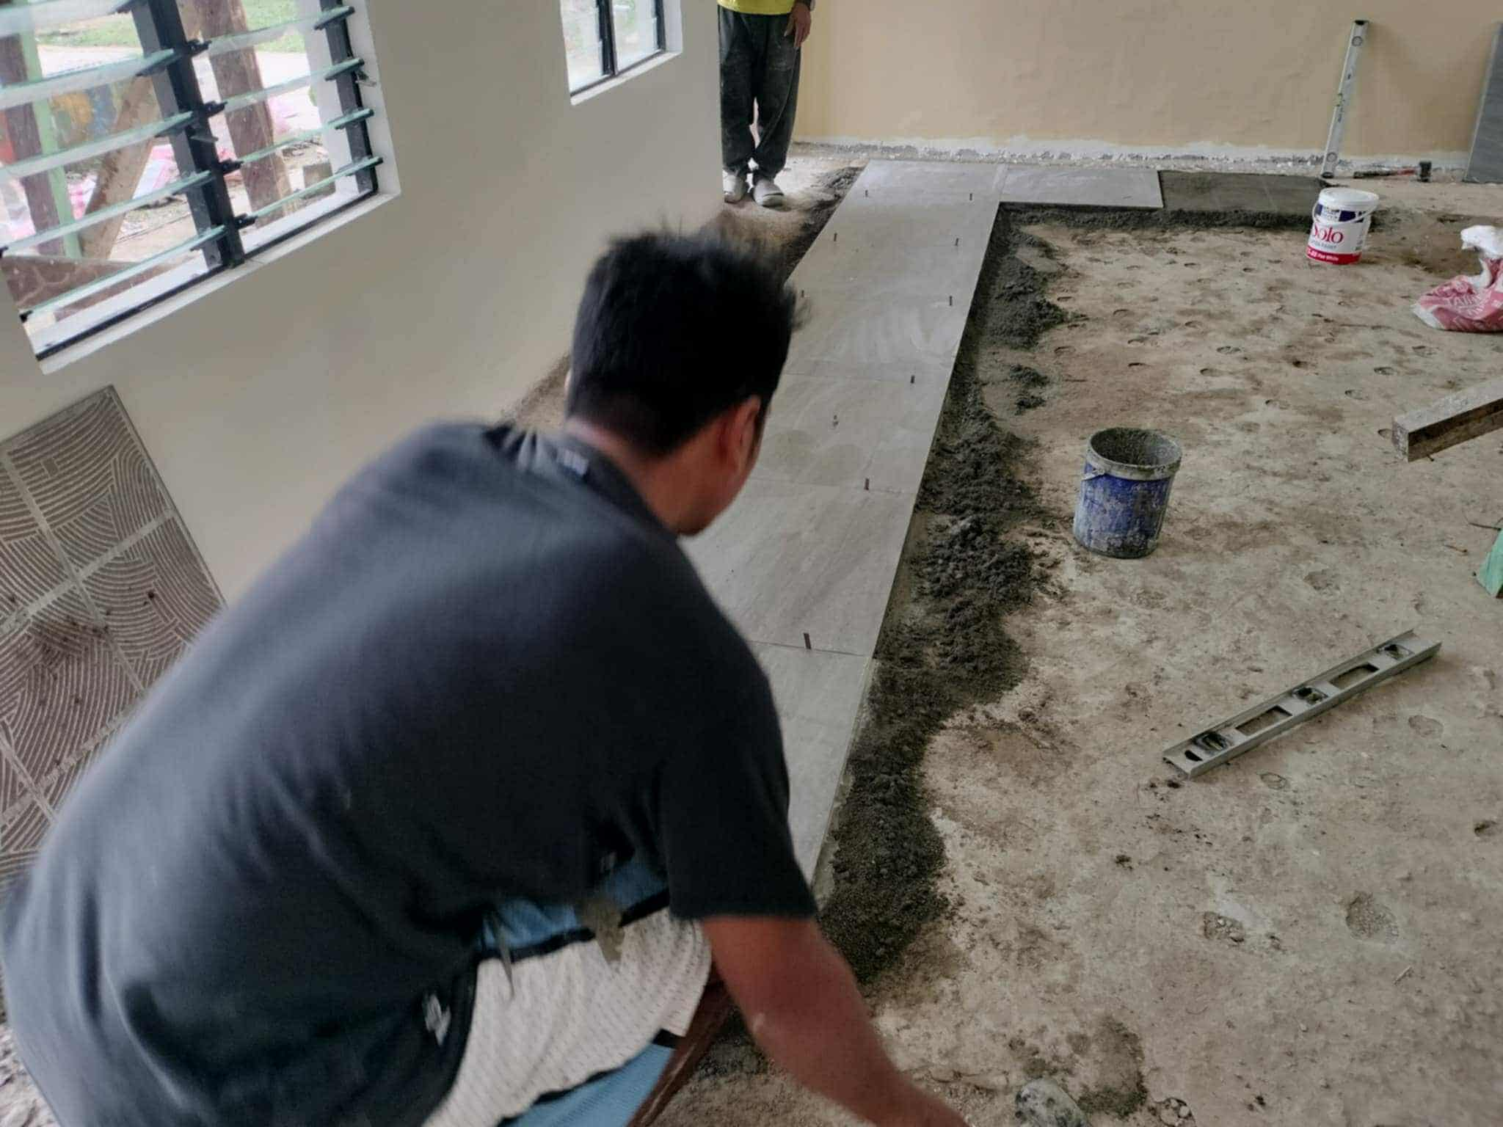

Slide 51
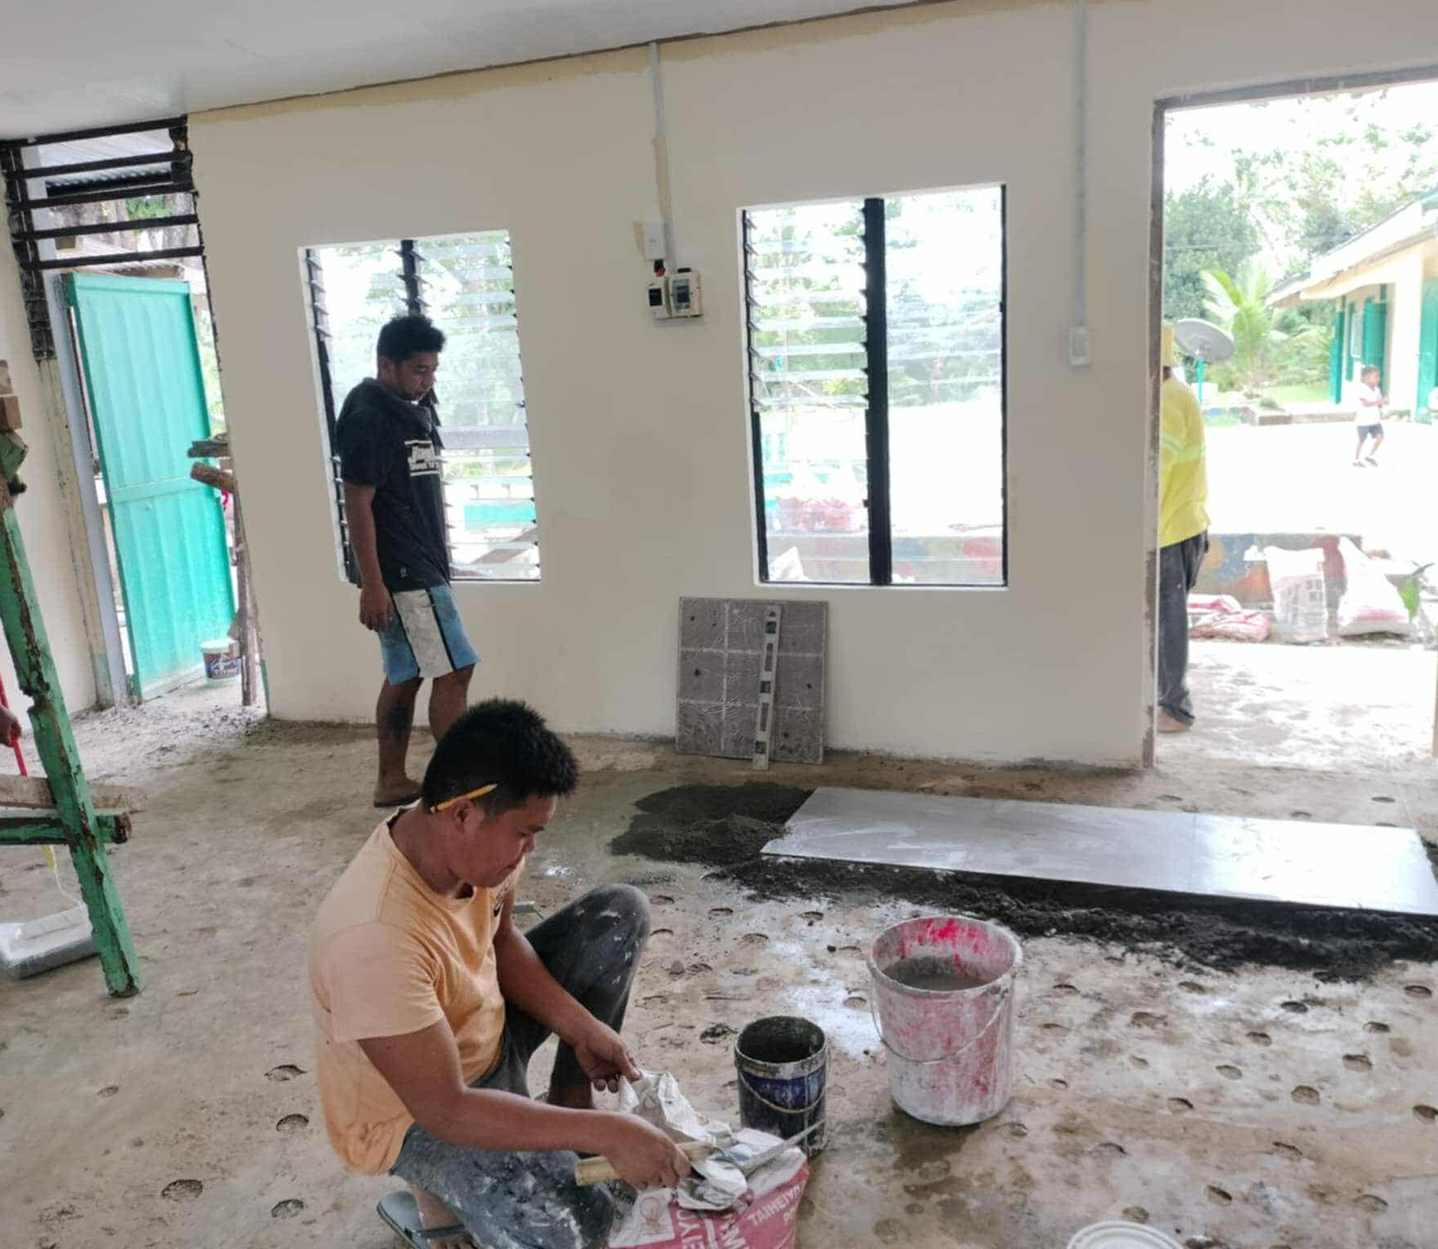

Slide 52
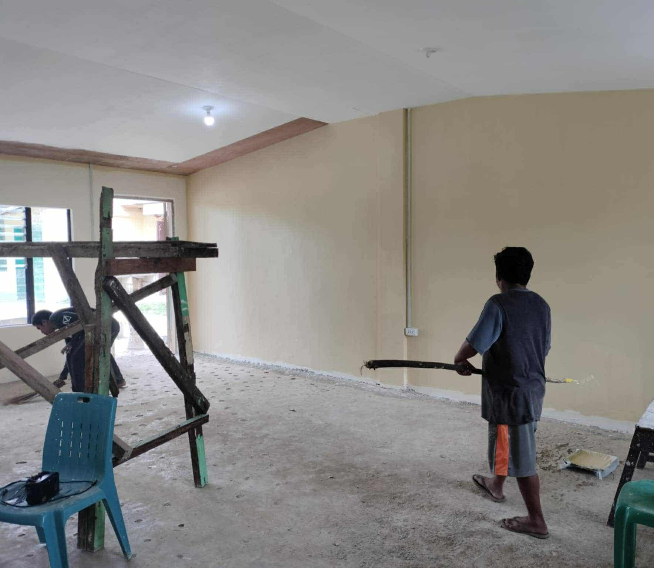

Slide 53
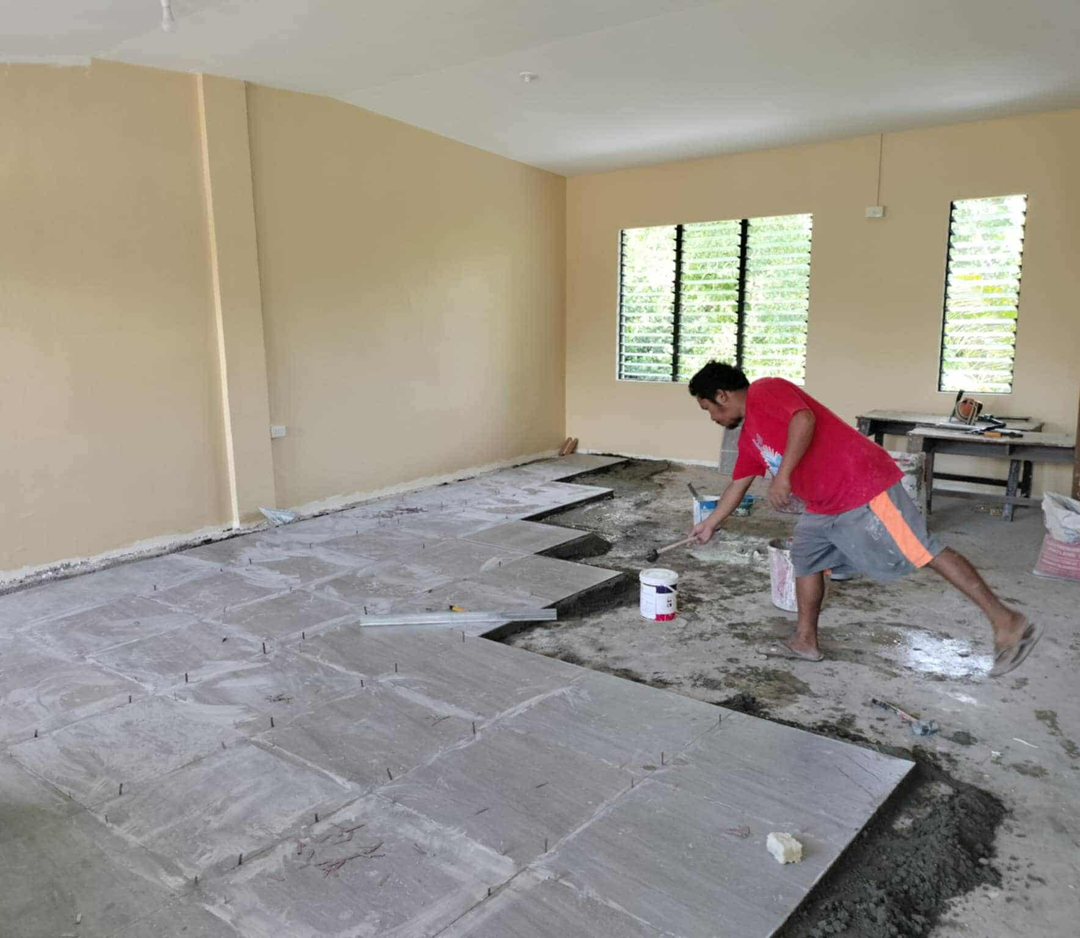

Slide 54


Slide 55


Slide 56


Slide 57


Slide 58


Slide 59


Slide 60


Slide 61


Slide 62


Slide 63


Slide 64



Slide 65


Slide 66


Slide 67

BLESSING

Slide 68



Slide 69


Slide 70



Slide 71


Slide 72


Slide 73


Slide 74

ON GOING
CLASSES

Slide 75


Slide 76


Slide 77
Thanks to your benevolence, our learners now have safe, spacious and inspiring spaces where they can dream, grew and thrive. Your contribution is a true statement to the power of community, generosity, and belief in the value of education for all.

Slide 78
To Mr. Thomas Amann and all the members and staff of Dr. Luppa Project Foundation, Amberg, Germany … thank you so much and may you continue to be blessed in your mission to uplift the lives of others. Please know that your kindness will always be remembered in our hearts and in every lesson learned within these walls. May God bless you all!

Slide 79



CHERYL P. GUIRITAN
Teacher-in-charge
SR. MA. LANI M. SALIGUMBA
Superior

Slide 80


